Slide 1
A Dynamic Approach of Analytic Geometry in 3D with TI N’Spire
Enhancing an Experimental Process of Discovery
14de T³ Europe Symposium
Oostende 22-23/08/2011
Jean-Jacques Dahan
jjdahan@wanadoo.fr
IREM of Toulouse

Slide 2
INTRODUCTION
Representing 3D objects in 2D with two parallel perspectives

Slide 3
The « cavaliere » and the « military » perspectives
« Cavaliere » perspective
« Military » perspective
PC.cg3
PM.cg3
Notes:
Refaire les deux fichiers et faire des plug ins et des liens vers les fichiers

Slide 4
Theses perspectives with dynamic numbers in the « Geometry » application of TI N’Spire
Paper1 problem 1

Slide 5
An example of representation
Circles in base planes
Paper1 problem 1

Slide 6
Another example using dynamic numbers:
Dynamic coordinates for movable points
Paper 1 problem 2

Slide 7
PART 1
CYLINDERS and CONES
Their representations in
« cavaliere » and « military » perspectives

Slide 8
With traces and loci
Paper1 problems 3, 4

Slide 9
PART 2
FOLDING and UNFOLDING
In « military » perspective

Slide 10
Folding and unfolding cylinders in « military » perspective

Slide 11
The technique
Paper1 problems 5

Slide 12
The result
Paper1 problems 5

Slide 13
Folding and unfolding cones in « military » perspective

Slide 14
The model
Paper2 problem 1

Slide 15
PART 3
The experimental process of discovery with technology
Two conjectures obtained with the model of unfolding a cone and their proofs

Slide 16
Unfolding a cone onto half a disk
Paper2 problems 2

Slide 17




Formal proof

Slide 18
Evaluation of a limit of a ratio
(between two angles)
Paper2 problem 3
Notes:
Ajouter une diapo pour visualiser le résultat

Slide 19
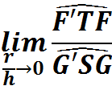
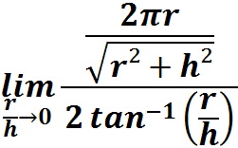
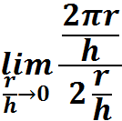
Formal proof

Slide 20
PART 4
SURFACES z = f(x,y)
Two possible approaches

Slide 21
With the « Graphs » application of TI N’Spire

Slide 22
Paper3 problem1

Slide 23
Paper3 problem 2

Slide 24
With the « 3D Graphing » tool of TI N’Spire

Slide 25
z = sin(x)+cos(y)
z = 0
Paper3 problem 3

Slide 26
z = sin(x)+cos(y)
z = 0
Paper3 problem 4
Notes:
Changer les formules

Slide 27
CONCLUSION as a new title
Dynamic numbers
for a dynamic approach
of 3D analytic geometry

Slide 28
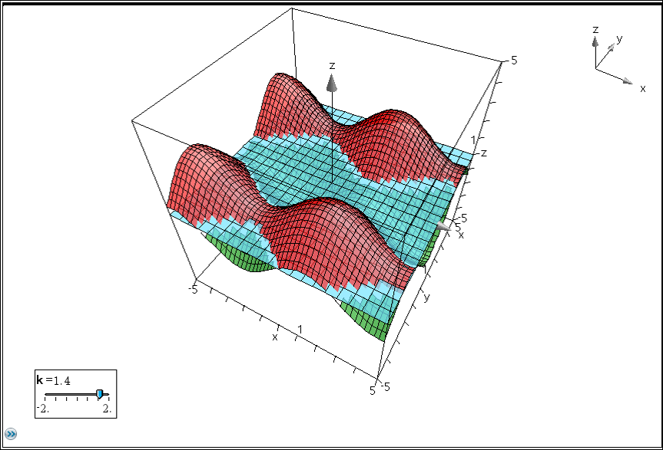
z = sin(x)- k.cos(y)
Paper3 problem 5

Slide 29
Dank
u wel!
jjdahan@wanadoo.fr

