Slide 1
Surviving in a Digital World
Ian Galloway
T3 Europe STEM lead
T3 Flanders
Brussels 2017

Slide 2
The Matrix
Notes:
The falling rain of numbers epitomises the extreme view of a digital world. Already, film-makers regularly construct images using algorithms and codes.

Slide 3
An interlude
Three items which have made the digital world possible
The flip flop
The transistor
The integrated circuit
Notes:
The flip flop is a multivibrator circuit invented in 1918 using valves at the time. Three types of flip flop are identified, the clock or astable, the memory or bistable and the timer or monostable. All three types incorporate two transistors.
The transistor was invented in 1947 and replaces thermionic valves. It is an electronic switch or amplification device.
The integrated circuit is one where all the components are created simultaneously providing extremely high reliability and the possibility of micr-miniaturisation.

Slide 4
For the whole of Recorded History starting with cuneiform
Notes:
The original computer tablet, made of clay and either erasable or permanent (fired or unfired). The use of the number in this image is unknown, but we still use the sexagesimal base today ….seconds and minutes.

Slide 5
Modern times;Compact Disc Bits or Pits
Notes:
The marks made in the clay are analogous to the marks made in compact discs. Red laser light on the left and blue on the right. The blue (shorter wavelength) laser was a later invention and allows more compact storage by having the pits closer together.

Slide 6
To the present day
Notes:
The ultimate in modern digital technology is the integrated circuit. Each bit in this storage device is a bistable requiring two transistors and other components. A one Gbyte memory has maybe 16 Gbits!

Slide 7
Education
Young people have an entitlement to have some knowledge of how their digital world is constructed.
It is they who will have to grow up and survive in it.
It is from the ranks of young people today that the engineers and designers of tomorrow will come from.
Industry right across Europe is complaining about the lack of engineers, right now.

Slide 8
The Big Challenges
Genomics
Water
Food
Air
Climate Change
Notes:
These are the social problems facing mankind today. They are the business of all human beings and all have a stake in the challenges confronting us. The challenges here are both ethical and technological.

Slide 9
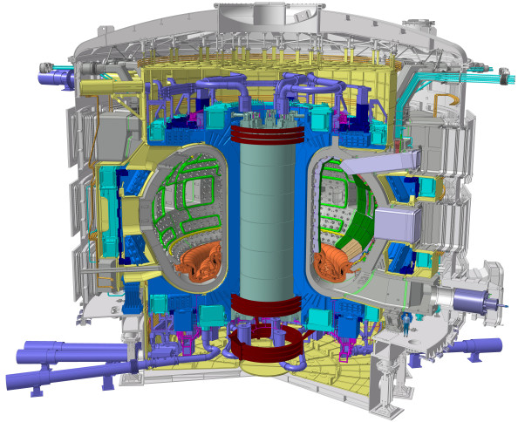
The Big Challenges
ITER:
the Divertor,
Being built in
Finland
European project
In Cadarache
Southern France
Notes:
Three big challenges are described here. All are technological and all require the use of algorithms and coding at the cutting edge of technology. All three could have enormous societal impact and are directly relevant to STEM in Europe.
ITER requires that a plasma at 200 million degrees be controlled by magnetic fields and contained within an enormous torus. This control is provided by the fastest computer processors available today and of course programs representing tens of thousands of hours of work.

Slide 10
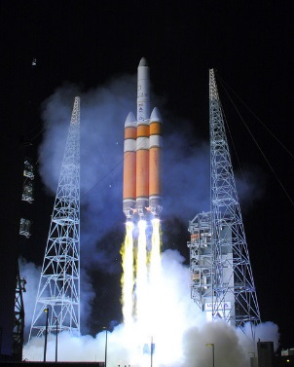
The Big Challenges
Mission to Mars:
the orbit
Europe is providing
System critical elements.
Testing of SLS ready for
Orion craft
Notes:
Similarly the code to calculate the orbits of rockets to Mars has to ensure precise locations after many months of travel. Small errors will result in enormous uncertainties in the flight path.

Slide 11
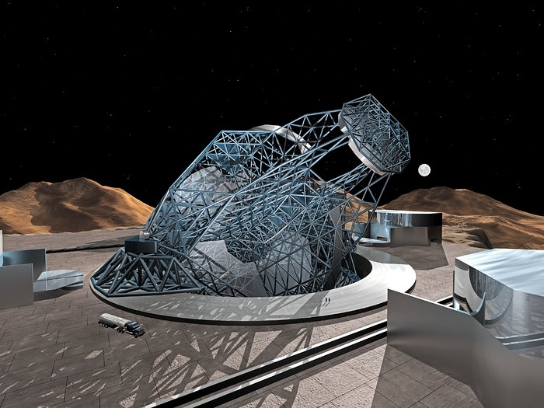
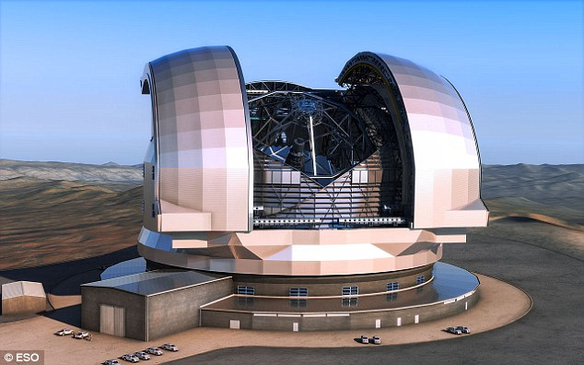
The Big Challenges
Owl 100m:
adaptive optics
European ELT
39m: in Chile
Notes:
Owl 100 m…..abandoned for the time being
ELT 39 m is an adaptive optics telescope. The mirror is adjustable with thousands of actuators or pistons behind it which adjust the shape of the mirror in order to account for irregularities caused by atmospheric distortion. This telescope will allow us to image planets in extra-solar systems.
All three of these devices are STEM objects. All the scientists and mathematicians are highly STEM literate and have a good engineering knowledge of the device they are building.

Slide 12
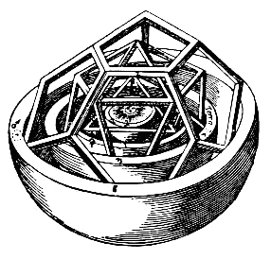
"My dear Kepler, what would you say of the learned here, who, replete with the pertinacity of the asp, have steadfastly refused to cast a glance through the telescope? What shall we make of this? Shall we laugh, or shall we cry?"
--Letter from Galileo Galilei to Johannes Kepler
Notes:
Presenting technology to the public was as difficult in the past as it is today. Galileo was unable to convince the consumers in 1600 of the value of his device. Today we are unable to convince education departments of the value of using digital technology in the classroom beyond presentation techniques.

Slide 13
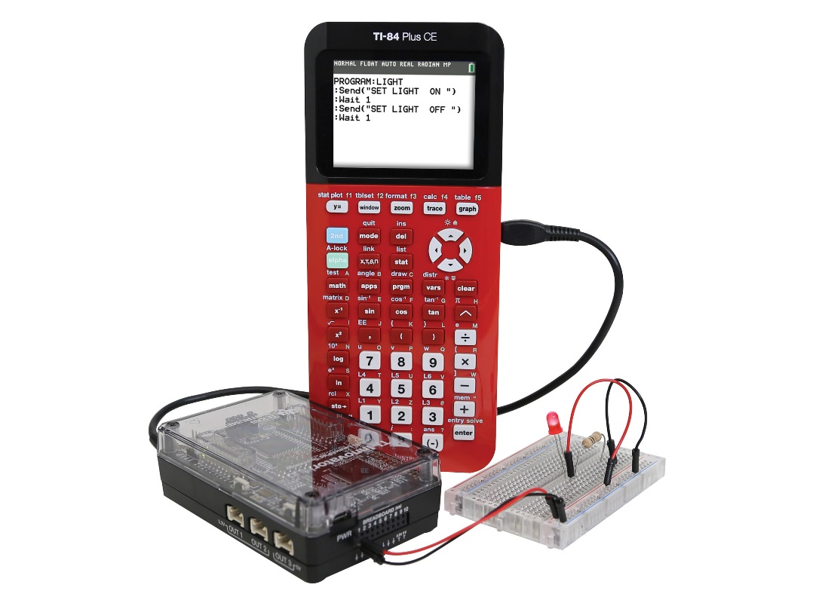
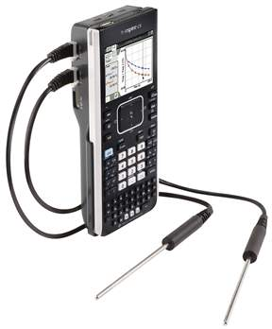
Digitisation
of Pictures
of Audio
of All measurable quantities
Quantisation
This is Science

Slide 14
Visualisation
Logic
Algorithms
Coding
Display
This is Mathematics
Notes:
We have the technology to allow young people to explore their digital world and have an understanding of how it is constructed. It is simply not possible to educate young people today for the world of tomorrow without embracing the technology we already have. The technology will change but the importance of providing support to survive in this digital world is becoming ever more urgent.

Slide 15
STEM
[nature] cannot be read until we have learned its language….it is written in mathematical language…
Galileo Galilei Il Saggiatore
There is a need for STEM literacy for survival in this digital world
Notes:
And this support is the notion of STEM literacy. It is not enough to be educated in science or mathematics. Engineering solutions to societies problems require that we are all STEM literate.

Slide 16
The STEM solution
Mathematics
And
Science
Using
Digital Tools

Slide 17
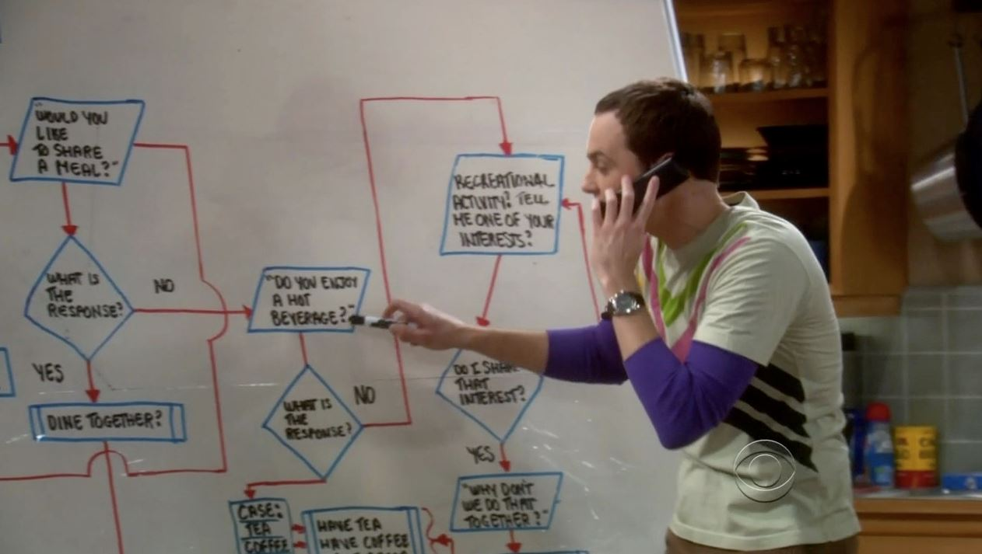
The T in STEM
Technology
Understanding the mathematics of nature and then being able to digitise and write algorithms allows us to construct codes which control the technology all around us.
This is often known as programming.
Notes:
The use of algorithms can be introduced at an early age and so provide the sort of thinking necessary to be able to write computer code. We are surrounded by digital devices which have an influence on all our lives. All young people have a right to have some understanding of how the digital world is created and so be more able to understand digital technology at the cutting edge. Some will go on to create the technology of tomorrow, ALL will be consumers.

Slide 18
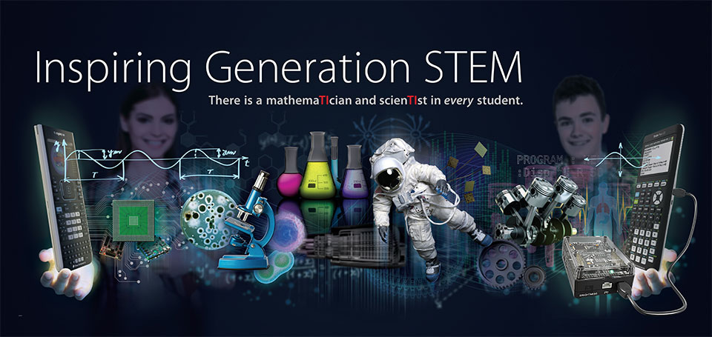
Coding
Digital technology is all around us and coding is key to having access to digital technology.
All young people should have access to coding …a moral right?
Coding allows all digital technologies to be controlled.
It requires an integration of science and mathematics to find engineering solutions.
STEM literacy is key to survival in this digital world.

Slide 19
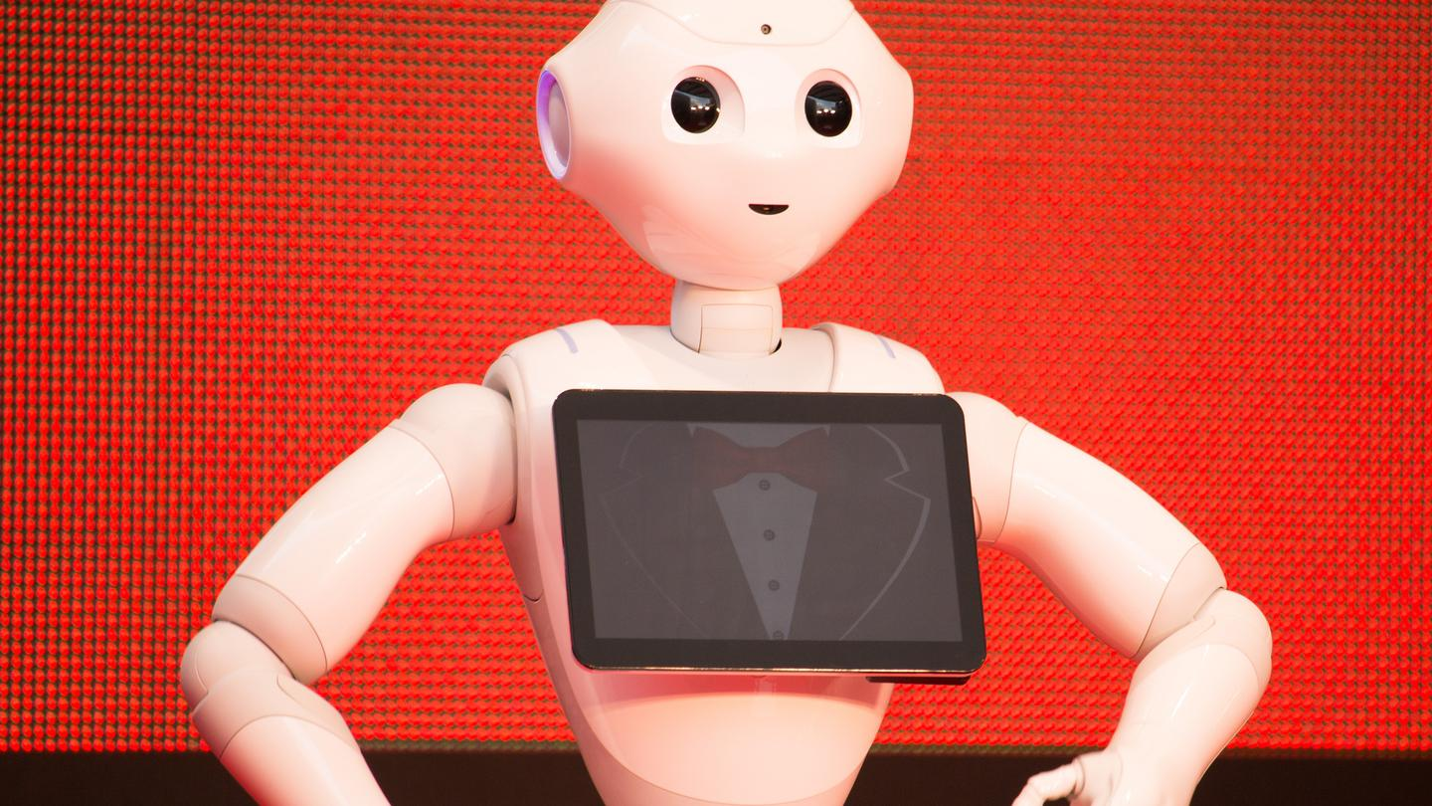
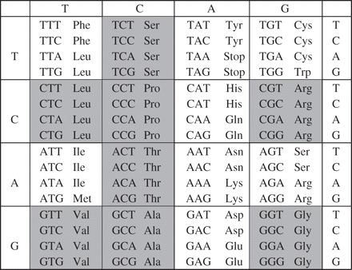
And tomorrow?
…we unequivocally believe that maths and science education are at the heart of improving our society and our economy.
(Michael Gove when Secretary of State for Education (UK) in a speech to the Royal Society, 2011)
Notes:
Two of the big unsolved problems for tomorrows STEM generation are the understanding of genetic code and what on earth we mean by artificial intelligence. We have examples of many fine words provided by politicians but until we have real STEM programs for schools we may not be able to survive in this digital world.

Slide 20
The end

Slide 21
2345467

