Slide 1
Jessica Kohout
Reservoir High School, US
jessica_kohout@hcpss.org
@MrsKohout
Kevin Spry
Texas Instruments
kspry@ti.com
@kspry

Slide 2
Changing the Face of STEM Education
Notes:
Ask for participation We think your perspective in this is valuable and would you mind sharing with the group?

Slide 3
Let’s draw an engineer
Notes:
Create a picture or word description of what you think of people that work within the STEM field. Share out images/text with group

Slide 4
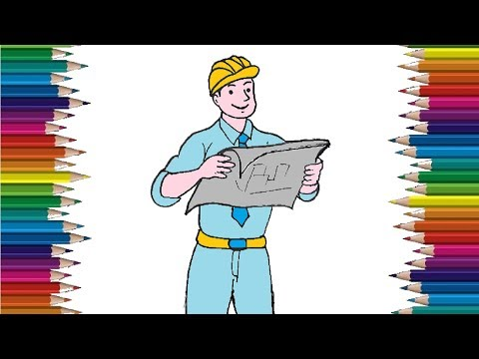

Slide 5
Who’s in the Room?
The usual (name, location, course(s))
What is your experience with STEM?
One outcome you hope for this session

Slide 6
What are common stereotypes of engineers?
test
Male, hard hat, computer, lots of play, white, team of men, glasses, middle age, nerd, gloves, hard skills, colourless, married, two children, machines, industrial, blow things up, Bob the Builder

Slide 7
Why do we care?
What are the costs?
Notes:
Short group discussion

Slide 8
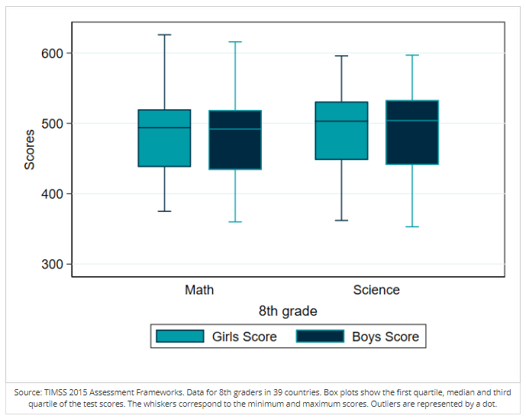
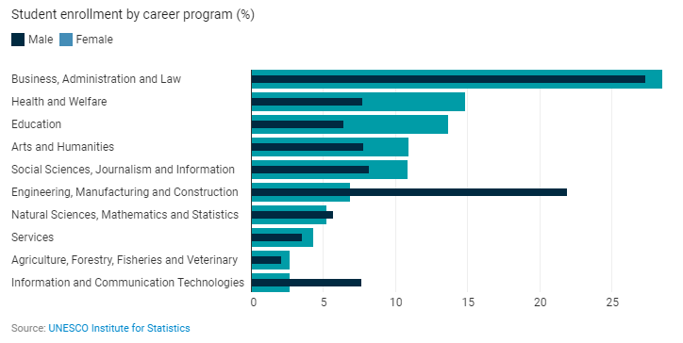
Why is this a problem?
Girls and boys perform the same in Math and Science in Secondary School.
Even with high rate of enrollment and graduation rates at the University level, women are less likely to major in a STEM field.
Notes:
https://blogs.worldbank.org/opendata/improving-pathway-school-stem-careers-girls-and-women

Slide 9
USA TODAY October 20, 2016
Women in computing to decline to 22% by 2025, study warns
SAN FRANCISCO-New research claims that at the current rate, the number of women in the computing workforce will decline to 22% from 24% by 2025 if nothing is done to encourage more of them to study computer science.

Slide 10
Why Do We Care
Article Excerpts:
Changing the Face of STEM
Save our Science
http://bit.ly/SI19STEM
Notes:
Split in half small group discussion

Slide 11
What are the benefits to a diverse STEM field?

Slide 12
Benefits of a Diverse STEM field
Notes:
Discussion - what else would you add as a benefit?

Slide 13
Why is it happening?
Small Group Activity
Why is it happening 1, 2, 3
http://bit.ly/SI19STEM

Slide 14
Potential Pathways to Change
Read article Pathways to Change

Slide 15
Potential Pathways to Change
This pathway starts with you!
What can you do to improve diversity in STEM?
Create a personal goal to implement within your school district.

Slide 16
Documents and Info:
Access to Documents: http://bit.ly/SI19STEM
Jessica Kohout
Email: jessica_kohout@hcpss.org
Twitter: @MrsKohout
Kevin Spry
Email: kspry@ti.com
Twitter: @kspry

