Slide 1
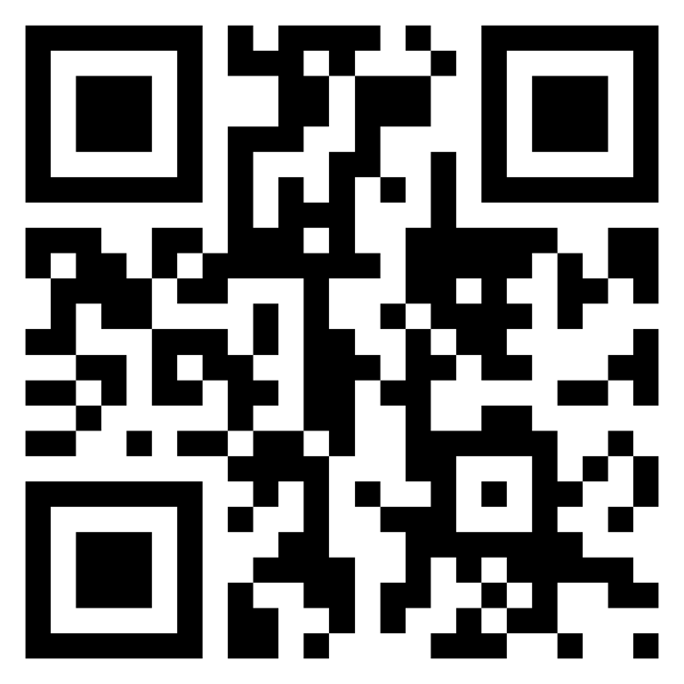
Meet the TI-Rover with Geometry Challenges TI-Nspire CXII Python
Texas Instruments
@ticalculators
www.TIstemProjects.com
Contact stem-team@ti.com with questions

Slide 2
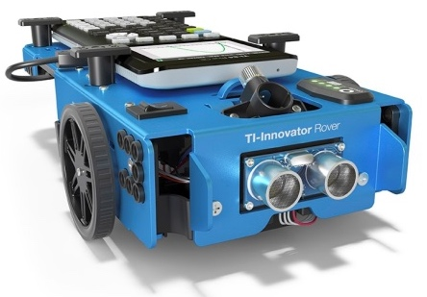
Meet the TI-Innovator Rover

Slide 3
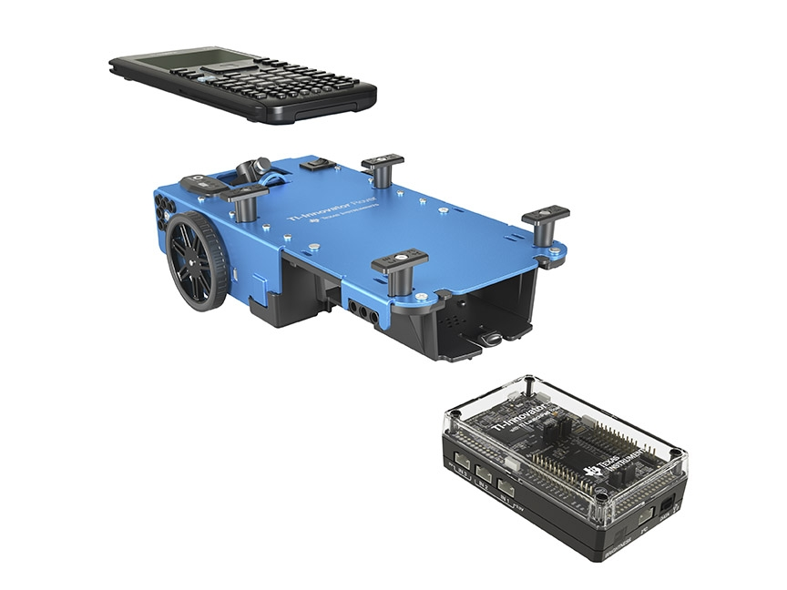
TI Graphing Calculator
TI-Innovator™ Rover
TI-Innovator™ Hub

Slide 4
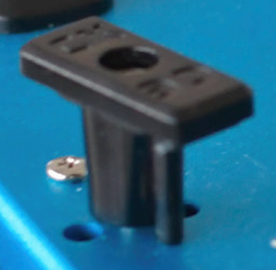
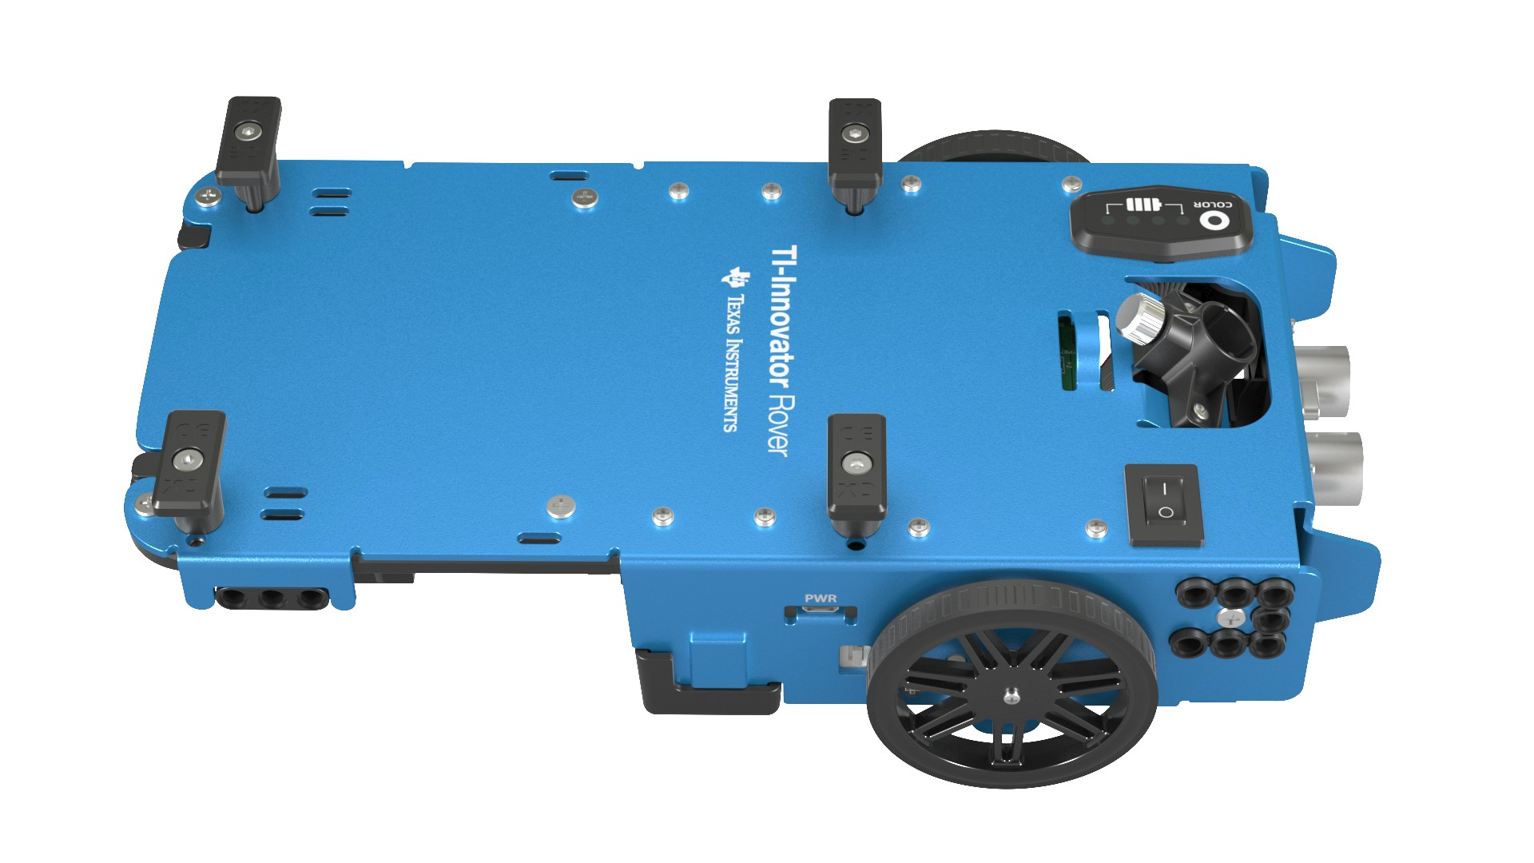
Rover from the top
Calculator holder posts.
Lift and twist to CE or CX side.
Red-Green-Blue (RGB) Color LED
Battery indicator
Marker holder
(Expo Fine and
Ultra Fine sizes)
Battery Charge with USB micro to wall adapter.
On/Off Switch

Slide 5
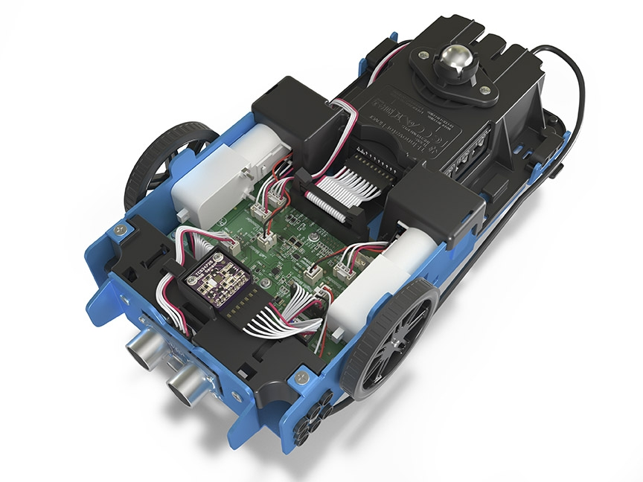
Turn Rover Over
What do you see?

Slide 6
Sensors on Rover
Motors to turn the wheels
Color sensor to detect different colors
Ranger to measure distance

Slide 7
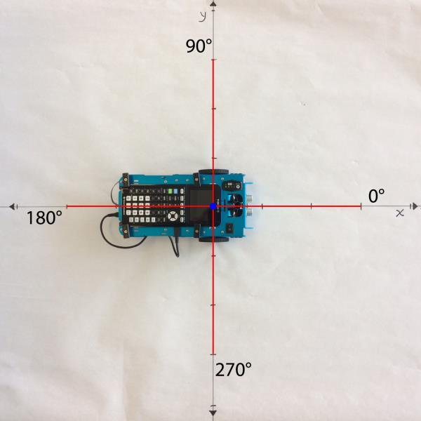
TI-Rover orientation and virtual grid
Rover programs set the initial position as the origin and the heading as 0 degrees measured from the x-axis.
Note: The Rover tracks its position on a virtual coordinate grid with a unit value of 10 cm. The coordinate grid position applies to the to_xy(x,y), to_polar(r,theta_degrees) and to_angle(angle, “unit”) functions on the Rover Drive menu. The virtual grid also applies to Path menu functions.

Slide 8
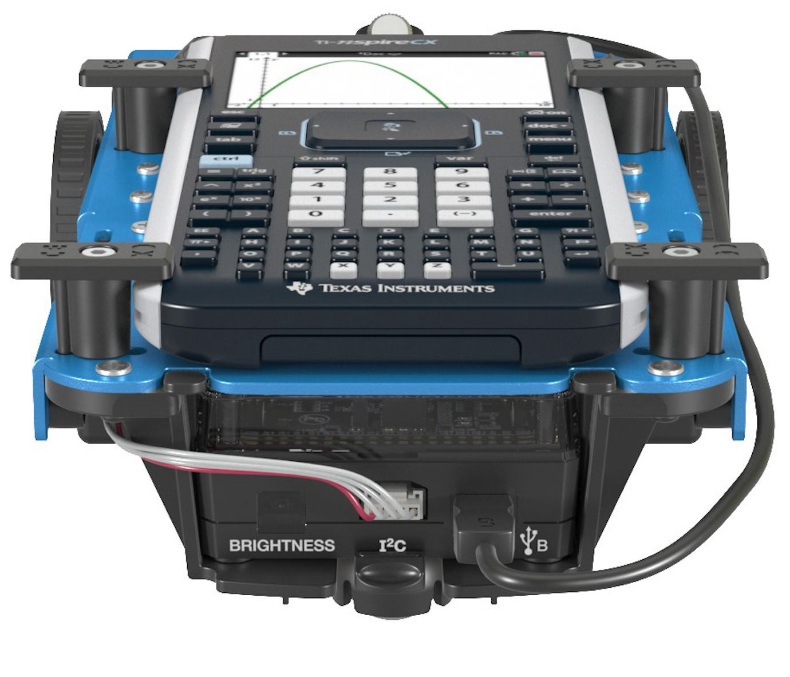
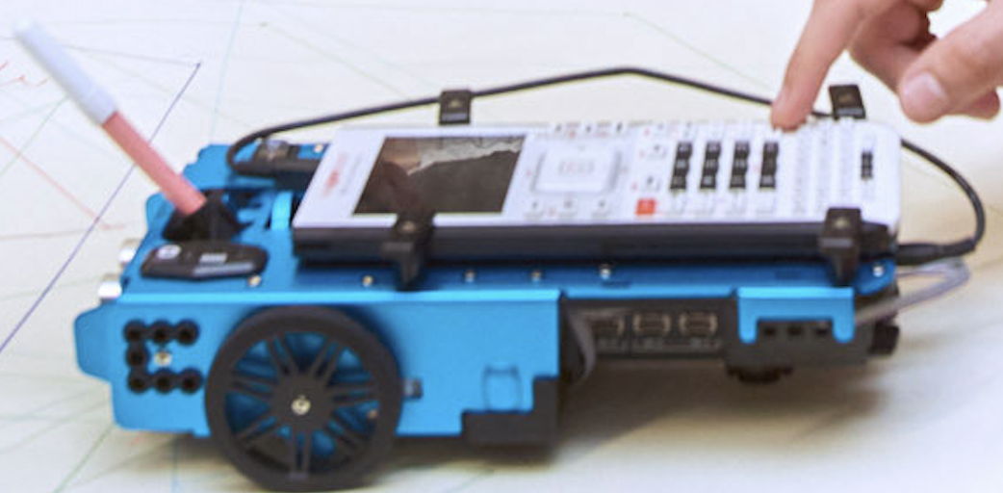
Connecting Rover to your calculator
1
Make sure that your Rover is switched ON and
on floor ready to roll before running the program.
2
3
Plug B side into USB B port of the Rover Hub.
Plug A side into port on calculator the Rover Hub.
Unit-to-unit cable

Slide 9
Connecting your calculator to the Rover
Initial Connection
Step 1: Make sure that Rover is switched ON
Step 2: plug unit-to-unit cable into Hub
(Use end of cable labeled B)
Step 3: plug unit-to-unit cable into the calculator
(Use end of cable labeled A)
Troubleshooting
Try the following as a fast fix:
Step 1: unplug the unit-to-unit cable from the hub and the calculator.
Step 2: re-connect in the order of first Hub then calculator second.
If the fast fix does not work, try these steps:
Step 1: unplug unit-to-unit cable from both the hub and the calculator
Step 2: Switch Rover OFF
Wait a second
Step 3: Switch Rover ON
Step 4: plug unit-to-unit cable into Hub
Step 5: plug unit-to-unit cable into the calculator

Slide 10
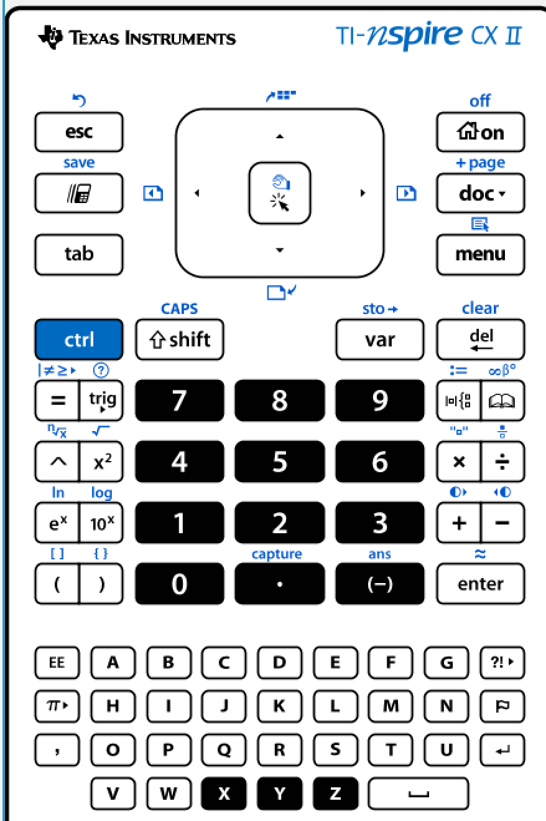
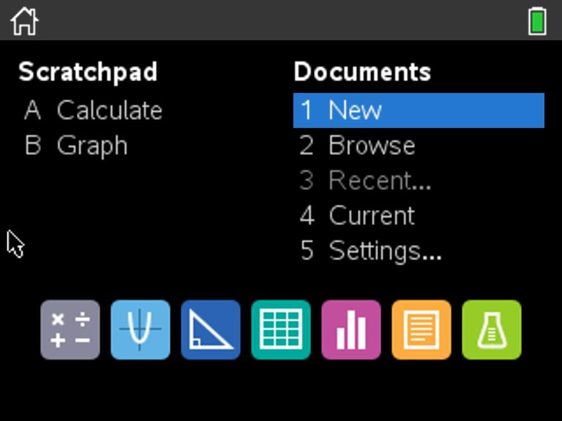
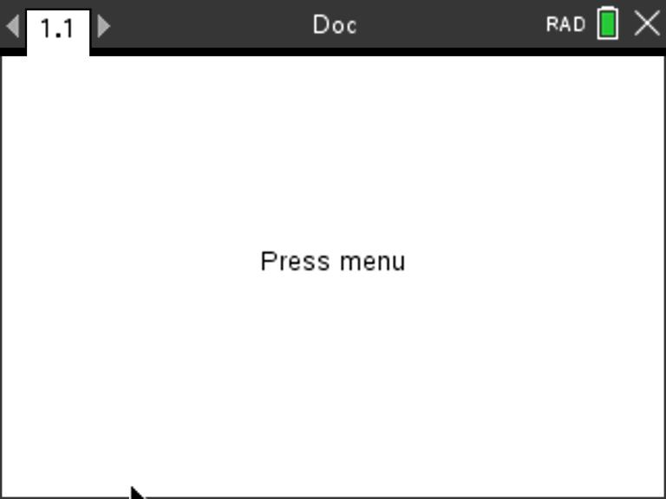
Creating a new TI-Nspire document
1
2
3
Use arrow keys and [enter] or
Press [1] to select 1 New document.
See next slide for steps to add
a program.
Press the [home/on] key to
display the home screen.
Note: If you have a document open, pressing the [home/on] key repeatedly toggles between the home screen and the document.

Slide 11
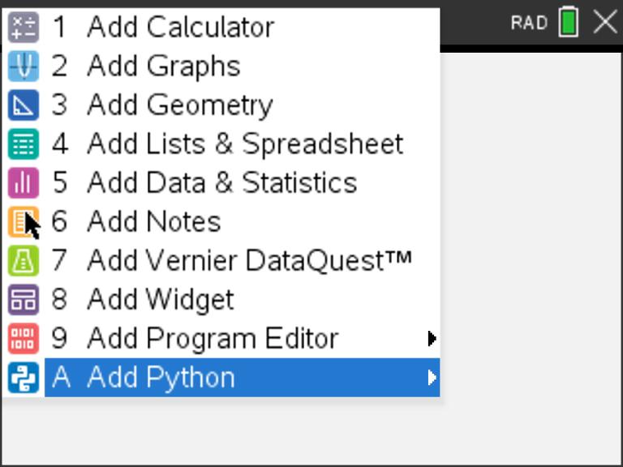
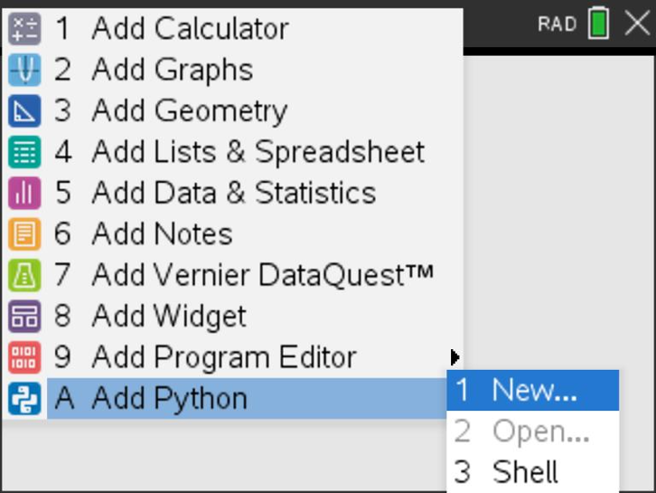
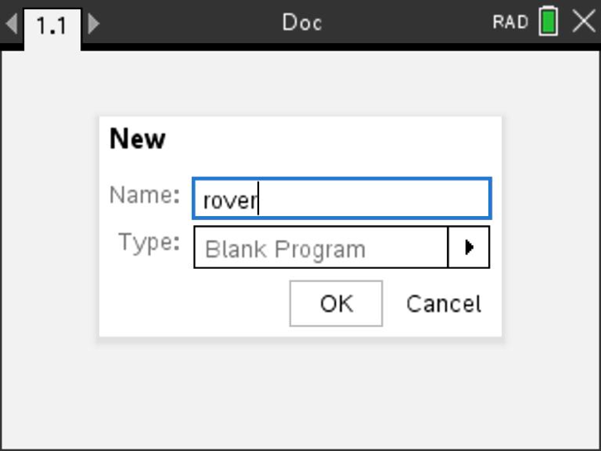
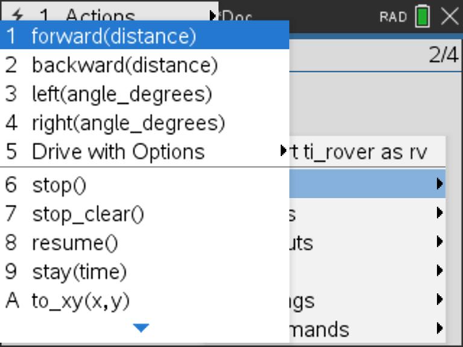
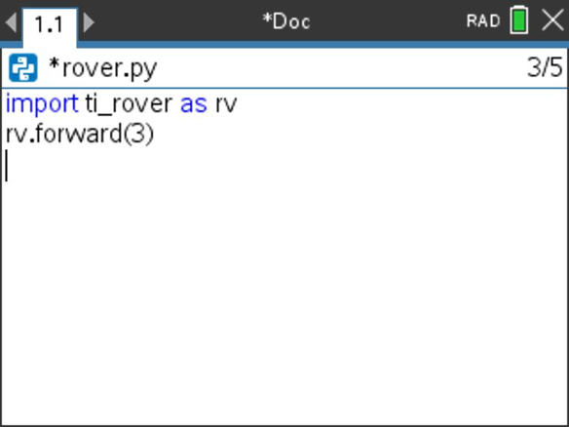
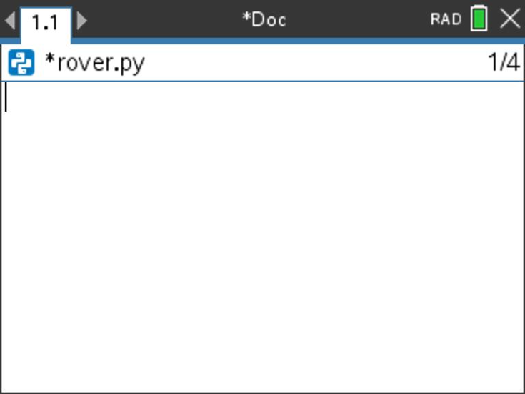
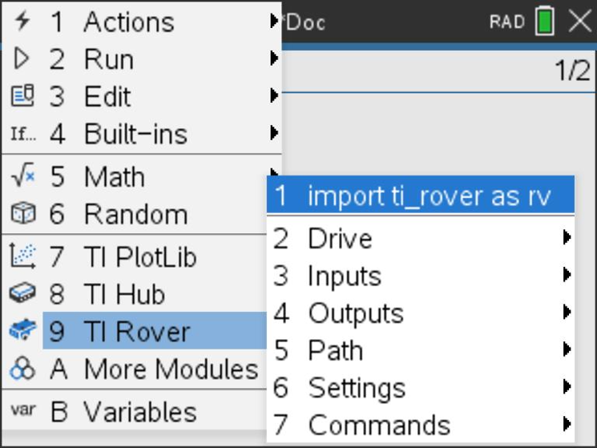
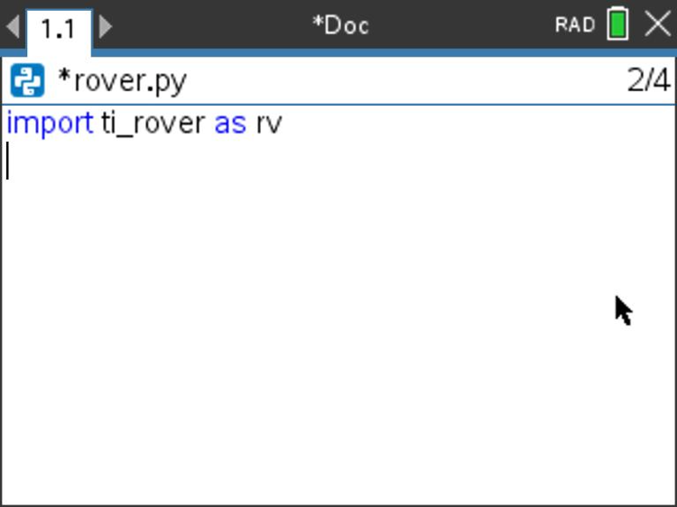
Creating a Rover Program
1
2
3
4
Press [menu] to bring up a menu
of applications to add to the page.
Press down arrow repeatedly then press [enter] or
press [A] to select Add Python.
Select 1: New by pressing [enter] or [1]
Enter your program name
and press [enter].
Note: You can also add a new page
to the document by pressing
[ctlr] [doc] +page.
8
5
6
7
Press [menu] then [9] TI Rover [2] Drive [1] forward() to paste to the edit line. Type a value for units to drive. Right arrow to the end of the line and press [enter] to complete the statement.
Press [ctrl] [R] to run the program from a Python shell on the next page.
You begin at a blank edit
screen.
Press [menu] then [9] TI Rover [1] Import ti_rover.
Importing the ti_rover module
is required at the beginning of every Rover program.

Slide 12
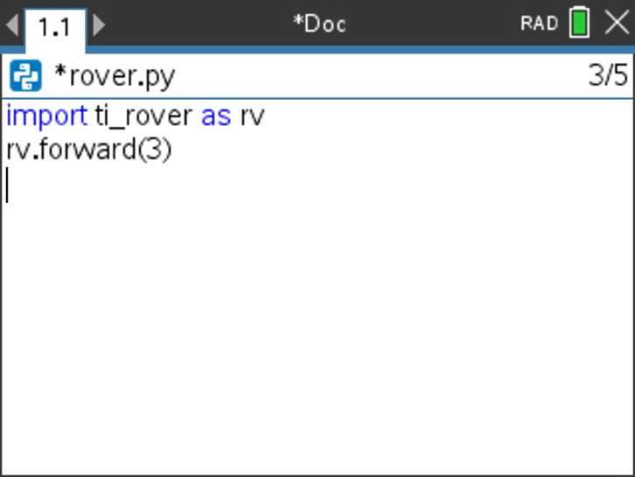
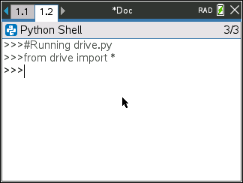
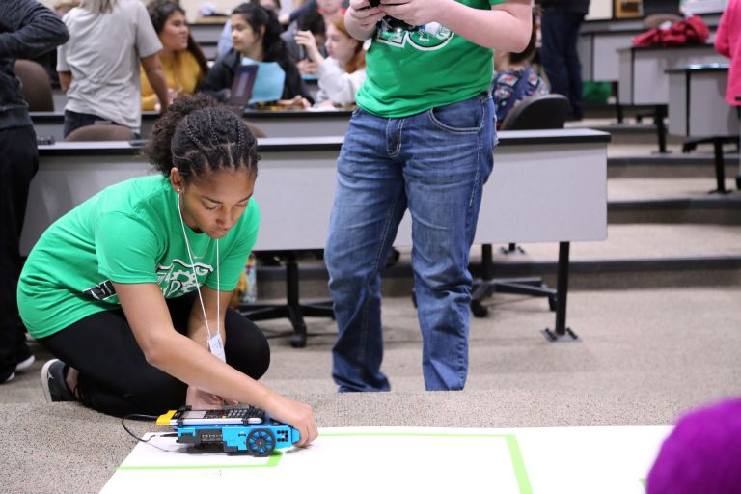
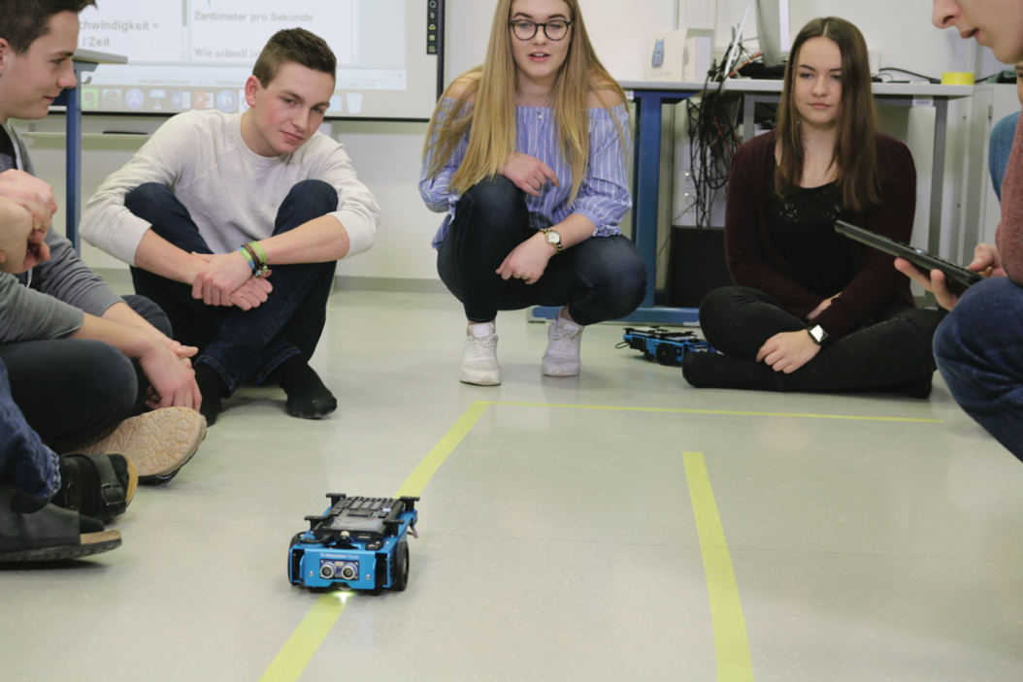
Running a Rover Program
1
2
Press [ctrl] [R] to run the program from a Python shell on the next page.
Note: [ctrl] [R] also checks syntax and stores program changes. [ctrl] [B] is another option for checking syntax and storing. * before the program name indicates that changes have not been stored.
Before running the program
make sure that
- Rover is connected to the calculator
- Rover is switched on
- Rover is on a flat surface ready to roll
Your program runs in a Python shell.
You can re-run the program from the shell by pressing [ctrl] [R] again.

Slide 13
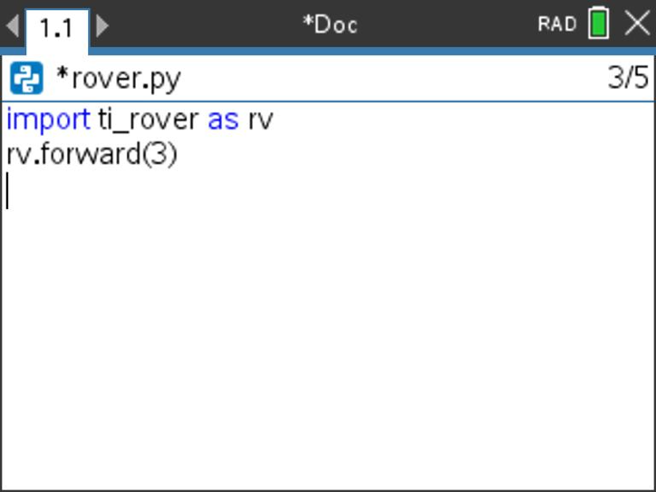
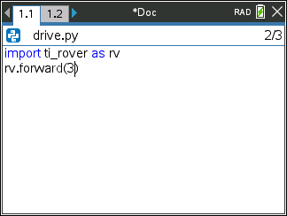
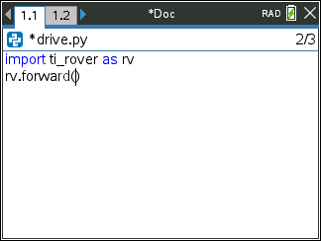
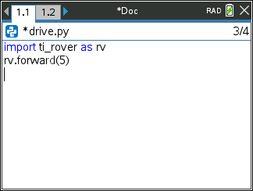
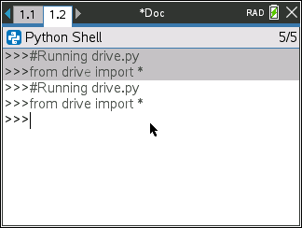
Editing a Rover Program
1
2
3
4
Press [ctrl] left to go back to your Python editor page.
Use the arrow keys to position the cursor to change the value of the forward distance.
Press [del] to backspace over the 3.
Type in a new value for distance,
right arrow to the end of the line,
then [enter] to move to the next
line.
5
6
Press [ctrl] [R] to run the program again from a Python shell on the next page.

Slide 14
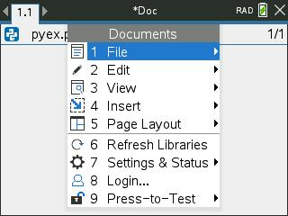
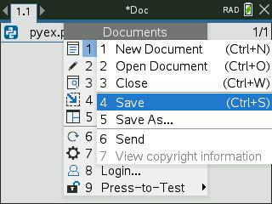
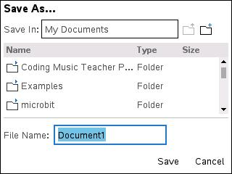
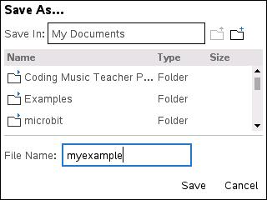
Saving a TI-Nspire document file
Folder where file will be saved.
1
2
3
4
Press [doc] then select 1 File
from the menu by pressing
[enter] or [1].
Select 4 Save or 5 Save As… from the menu.
Type in your file name using alpha and numeric characters.
Note: The name must begin with an alpha character.
Press [enter] to save the file to the
folder indicated above.
To change the folder press the
[UP] arrow key and then use
arrows and [enter] to select a
folder before pressing [enter] to
save the file.
Press [esc] to cancel the save
dialogue.
You can use [ctrl] [S] as a shortcut
to save the TI-Nspire document file.

Slide 15
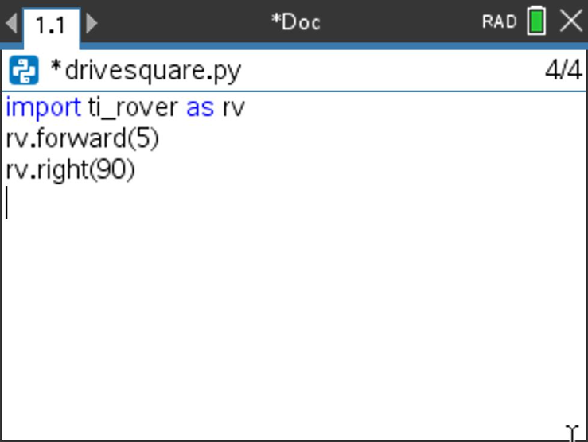
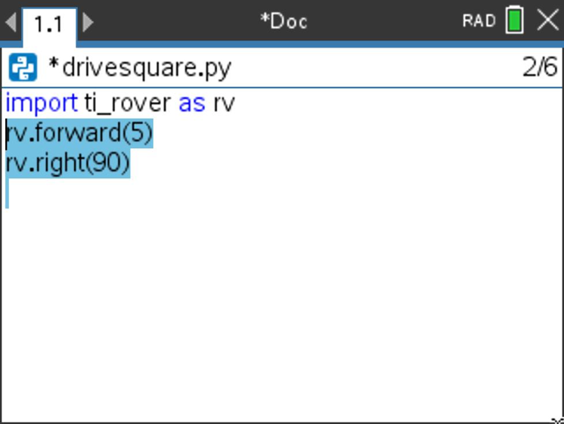
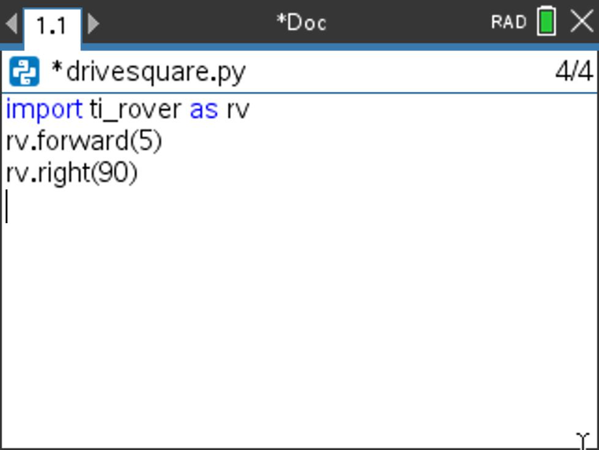
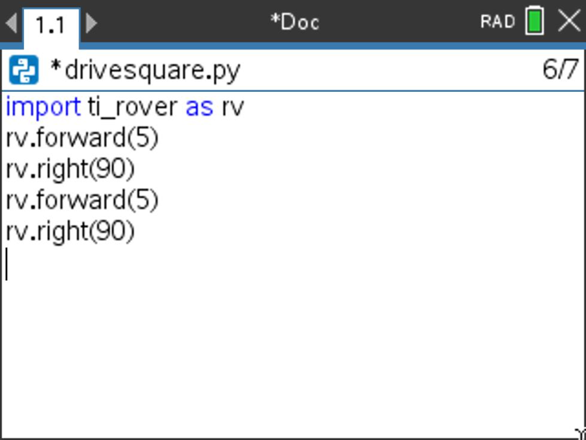
Copying and Pasting a Block of Code
1
2
3
4
Use arrow keys to move the cursor to the beginning of row below the section of code that you want to copy.
Press and hold [shift] then press UP arrow repeatedly to highlight the rows to be copied. Press [ctrl] [C] to copy the highlighted code.
Use arrow keys to move the cursor to the location that you want to paste from.
Press [ctrl] [V] to paste.
You can paste repeatedly.

Slide 16
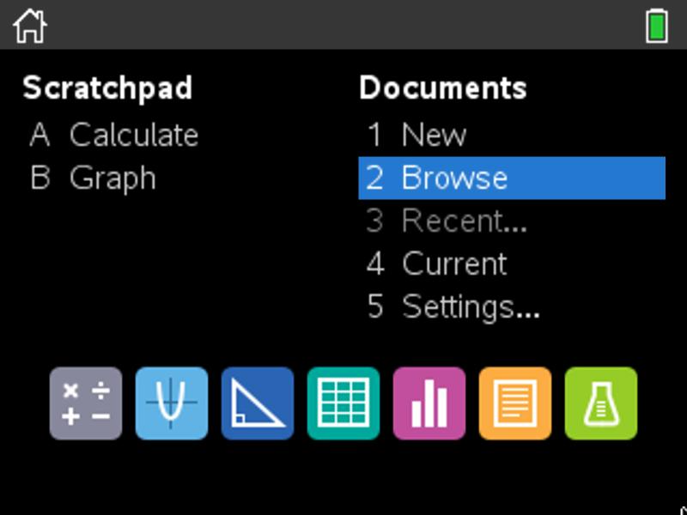
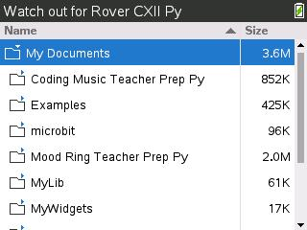
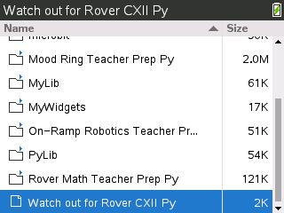
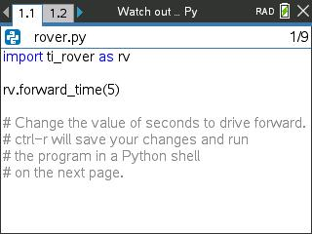
Opening an existing TI-Nspire document file
1
2
3
Use arrow keys and [enter] or
Press [2] to select 2 Browse files.
Use arrow keys and [enter] to select a folder and a file.
Note: Pressing the [home/on] key
repeatedly toggles between the home screen and the current document.
Press the [home/on] key to
display the home screen.

Slide 17
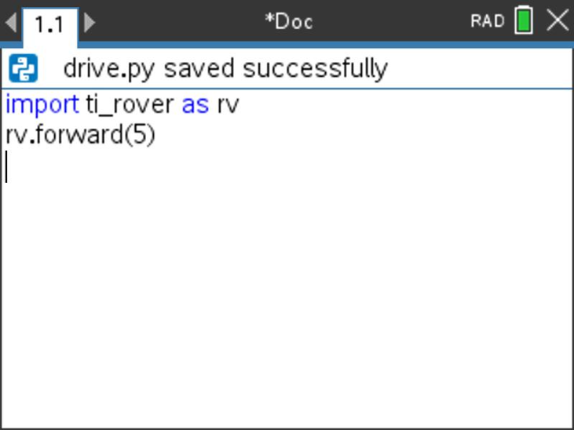
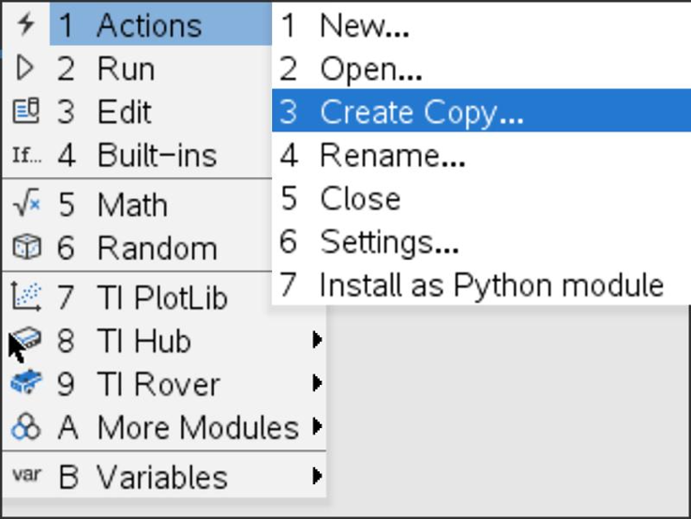
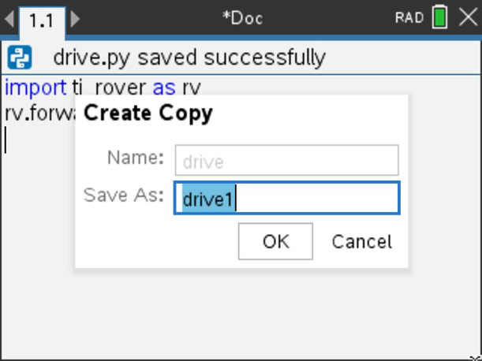
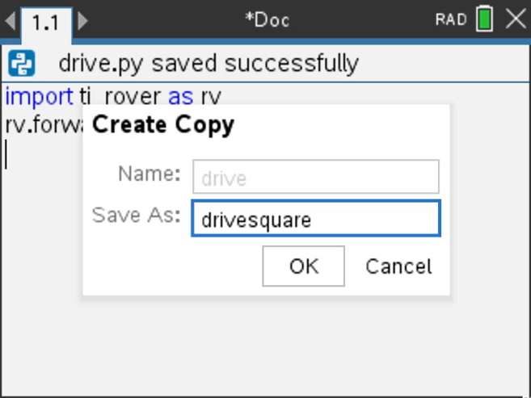
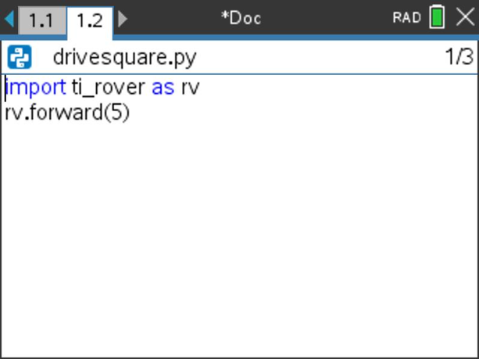
Copying a Python Program
1
2
3
Press [ctrl] [B] to compile and save your program.
Note: You will not be able to copy the program if you have made changes since using [ctrl] [R] or [ctrl] [B].
Press [menu] [1] Actions
[3] Create Copy…
Type in your new program name. Press [enter] to complete the dialogue.
The new program is inserted on the page after the original page, in this case page 1.2.

Slide 18
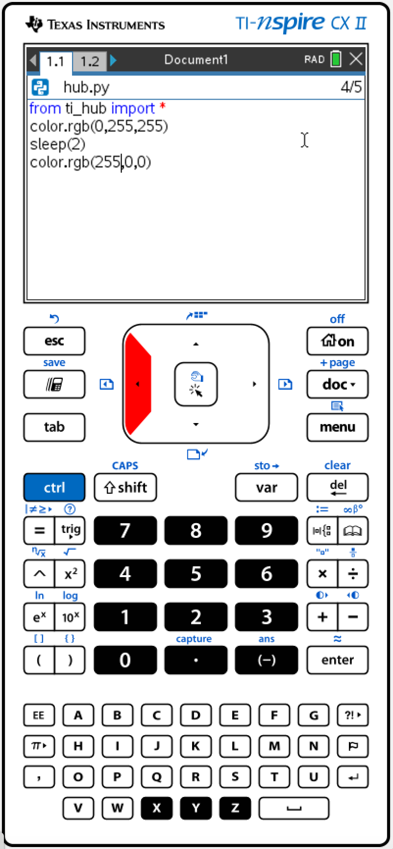
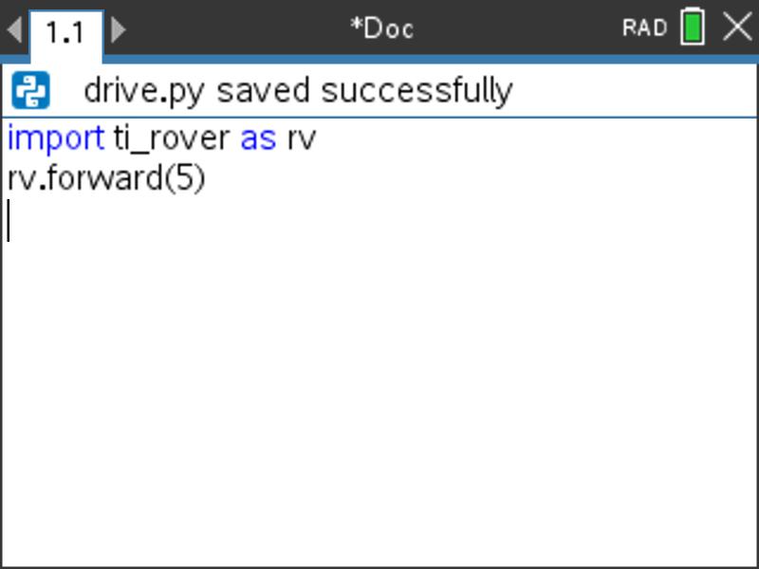
Entry and Edit Tips
Use number key shortcuts or arrow keys and [enter] to select from menus
Use [esc] to back out of a menu or a dialogue.
Use [enter] to complete a dialogue.
Use [tab] to move to the next input when entering a function
Use arrow keys to move the cursor around the screen
Use [del] as a destructive backspace
Use [ctrl] [enter] to complete a statement and move to the next line
Use [ctrl] [Z] to undo an action
Use [ctrl] [S] to save your file
Use [ctrl] [left arrow] and [ctrl] [right arrow] to move from page to page
Use [menu] to see options for the current application.

Slide 19
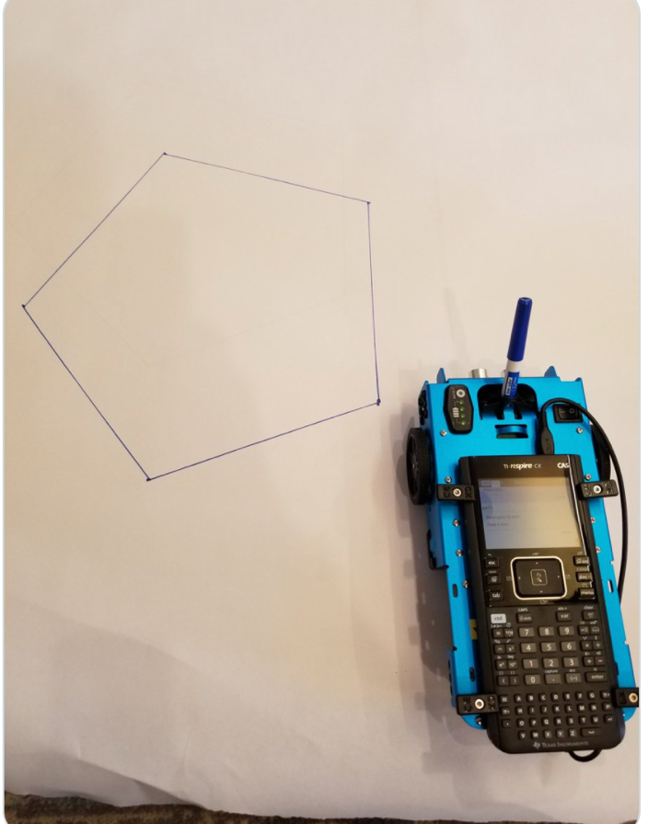
Drawing with the TI-Rover
Use Expo Fine or Extra Fine dry erase markers.
The markers drop into a slot on the front of the Rover.
Note: The Texas Instruments Workshop Loan Rover cases include markers.
Drawing surface: We recommend butcher paper held in place with painters tape on a hard surface.

Slide 20
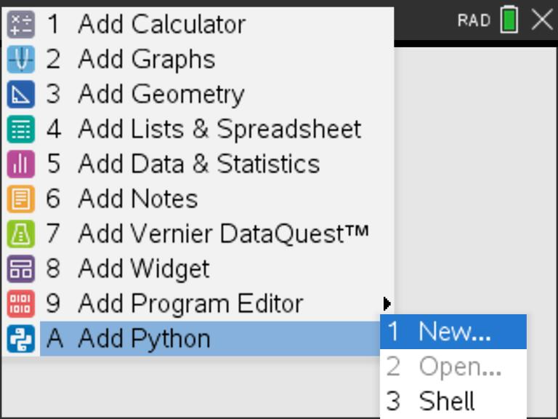
Creating an Advanced Rover Program
1
2
3
Press [menu] to bring up a menu
of applications to add to the page.
Press down arrow repeatedly then
press [enter] or press [A]
to select Add Python.
Select 1: New by pressing [enter]
or [1]
7
Note: You can also add a new page to
the document by pressing
[ctlr] [doc] +page.
5
4
6
Press Down arrow then
Press Right arrow
to bring up a menu
of program types.
Your program now includes import statements for Python modules used
in a variety of Rover programs. You can select Python functions to add to your
program by pressing [menu].
Press [ctrl] [R] to run the program
from a Python shell on the next page.
Press down arrow repeatedly to Rover Coding option
then press [enter]
Enter your program name.

Slide 21
MAKE IT MOVE!
New Program:
Task: Discover how far Rover drives per unit.
Use differing values (1-20) to determine what 1 Rover unit is.
Find import ti_rover on the TI Rover menu.
Find forward() and other drive functions on the Rover 2:Drive menu.
Press [menu] key to see Python Program Editor options.
Press [ctrl] [R] to run the program from a Python shell on the next page.
Use [ctrl] left to move from the shell page back to the Python editor page.
Notes:
Explain import ti_rover module
Then demo how to import and how to enter the statements.
Give students time to explore with different distances to figure out.
Use [ctrl] left and [ctrl] right to move from page to page in the document.

Slide 22
Set the color
New Program:
Task: Set the color output of the RGB LED.
Each color takes a value (0-255).
Challenge Task: Try to make Yellow
Find the color_rgb( ) function on the Rover Outputs menu.
Press [menu] key to see Python Program Editor options.
Press [ctrl] [R] to run the program from a Python shell on the next page.
Use [ctrl] left to move from the shell page back to the Python editor page.
Notes:
Explain import ti_rover module
Then demo how to import and how to enter the statements.
Give time to explore.

Slide 23
Explore angles
New Program:
Task: Drive a square.
Challenge Task: Try to drive an equilateral triangle.
The program above is a framework for driving a square. Enter values for distance and turn angle.
Press [menu] key to see Python Program Editor options.
Press [ctrl] [R] to run the program from a Python shell on the next page.
Use [ctrl] left to move from the shell page back to the Python editor page.
Notes:
Explain import ti_rover module
Then demo how to import and how to enter the statements.
Give time to explore.

Slide 24
Quick Math Reminders
Complementary Angles:
Sum to 90 degrees
Supplementary Angles:
Sum to 180 degrees

Slide 25
Quick Math Reminders
Exterior angles:
Interior Angles:

Slide 26
Logic Challenge
Task: Drive the figure shown without crossing any lines or going back over a line and without picking up the pen.
When you are ready put the pen in and trace your path
Notes:
First challenge is to drive the shape without crossing any lines and without picking up the pen.

Slide 27
Where can you go next with TI-Rover?
Drive an obstacle course
Drive a design
Draw artwork
Use a For loop
to draw polygons
Write your name
Navigate a map
Park your Rover

Slide 28
Quick Math Reminders
Pythagorean Theorem

Slide 29
Logic Challenge 2
Task: Drive the figure shown without crossing any lines or going back over a line and without picking up the pen.
When you are ready put the pen in and trace your path
Import the Python Math module in addition to the Rover module for this challenge. The Math Module is needed for Square Root and other advanced functions.
Notes:
We will need to import the math library
First challenge is to drive the shape without crossing any lines and without picking up the pen.
Second will be to drive at least one segment in reverse direction.

Slide 30
Logic Challenge 2
3
2
4
5
6
1
7
9
8
10
Notes:
We will need to import the math library
First challenge is to drive the shape without crossing any lines and without picking up the pen.
Second will be to drive at least one segment in reverse direction.

Slide 31
Logic Challenge 3
Task: Drive the figure shown without crossing any lines or going back over a line and without picking up the pen.
Now match the colors using the RGB LED. Don’t worry about using the pen.
Import the Python Math module in addition to the Rover module for this challenge.
Use wait-until_done() from the Rover Commands menu to synchronize Rover drive functions with the RGB LED.
Notes:
We will need to import the math library
First challenge is to drive the shape without crossing any lines and without picking up the pen.
Second will be to drive at least one segment in reverse direction.

Slide 32
Thank You
www.TIstemProjects.com
Contact stem-team@ti.com with questions

