Slide 1
Sharing Inspiration webinar May 2022
Temperature

Slide 2
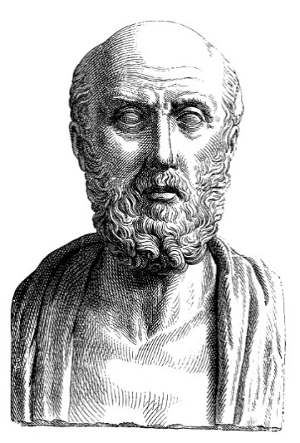
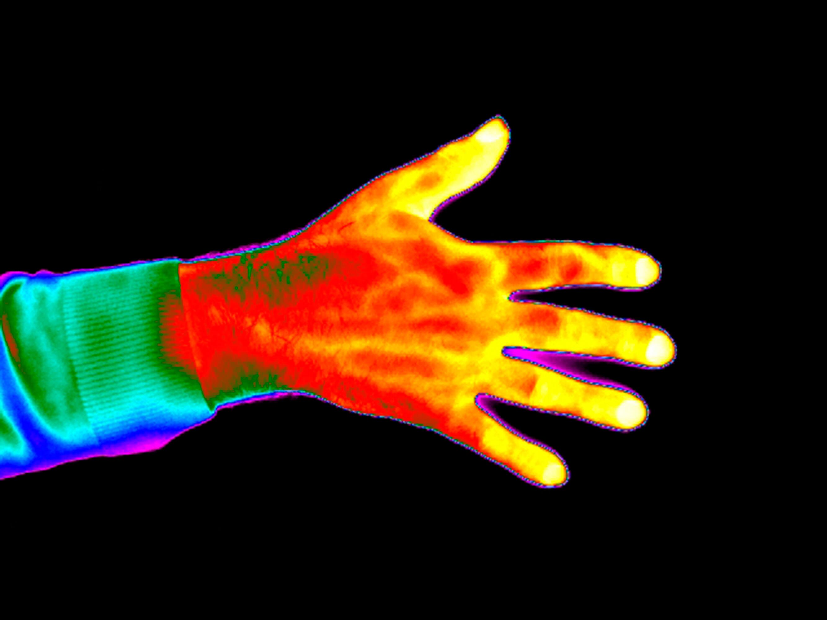
Early ideas, touch
Hippocrates 460-370 BCE
First use of thermographs

Slide 3
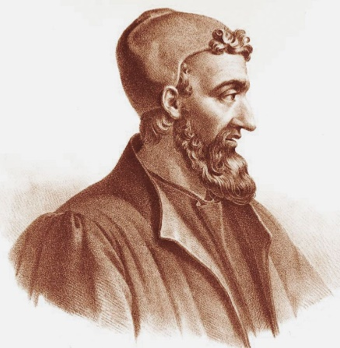
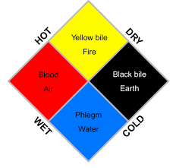
Early ideas, a scale?
Galen, ancient Greek in the Roman Empire (130-220 CE)
Humours from Hippocrates
Elements from Aristotle
Astrology from Plato

Slide 4
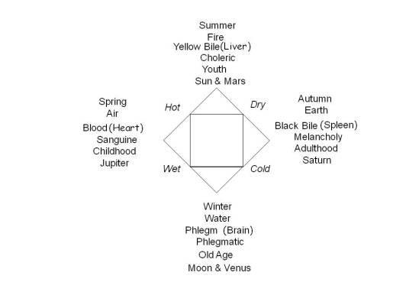
Early ideas, a scale?
Galen, ancient Greek in the Roman Empire (130-220 CE)
Humours
Elements
Planets
8 division
temperature scale!

Slide 5
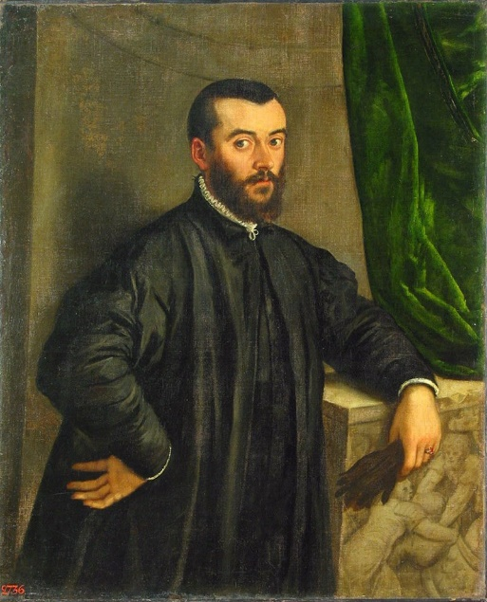
Early ideas, Vesalius Belgian (1514-1564)
De Humani Corporis Fabrica. 1543
Published same year as
De Revolutionibus Orbium Coelestium by Copernicus.
Clearly a signal year for the Siécles des Lumières:

Slide 6
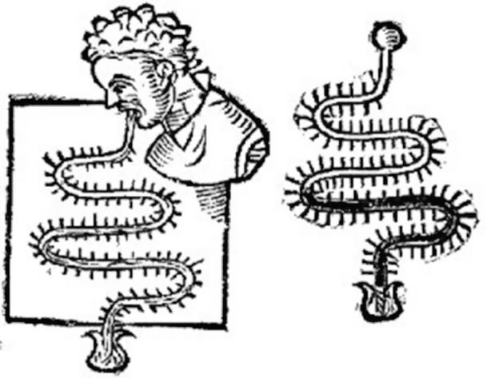
Thermoscopes
Galileo and Santori 1612
bulb placed in mouth
open end placed in beaker of water

Slide 7
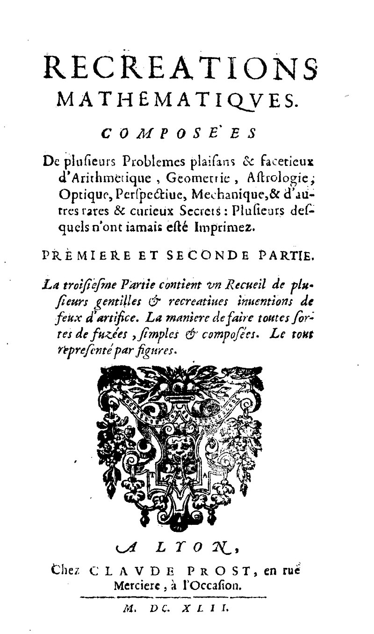
Thermometer at last!
1621 Jean Leurechon describes a
thermoscope as a “thermometer“
and assigns an 8 division scale to it!

Slide 8
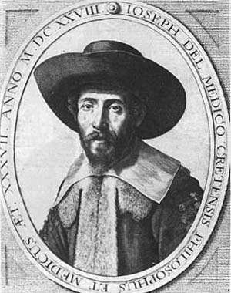
1629 a sealed glass thermometer
Joseph Delmedigo Cretan?
1591-1655, lived in Italy,
Student of Galileo and Santori

Slide 9
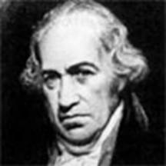
At last, a sealed glass thermometer with a scale 1724
Daniel Gabriel Fahrenheit 1686-1736
German but lived in the Netherlands.
Accepted theory is that he met Ole Roemer,
Freezing brine 0 melting ice 30 body 90..(216 boiling water, not 240!)
Then
(0)…………….32………………96…..( 205 boiling water )
Finally
(0)……….32………(98.7) ………..212

Slide 10
My theory….take it or leave it!
Brine 0……(melting ice 30)………..body (horse?) 100
Noticed that water froze at 32, not 30,
(0)……32…………96…………….(205)
For the Royal Society presentation
(0)…….32…………..(98.7)……….212
(http://s.bourdreux.free.fr/cabinet_Sigaud/chronologie/fahrenheit.htm)

Slide 11
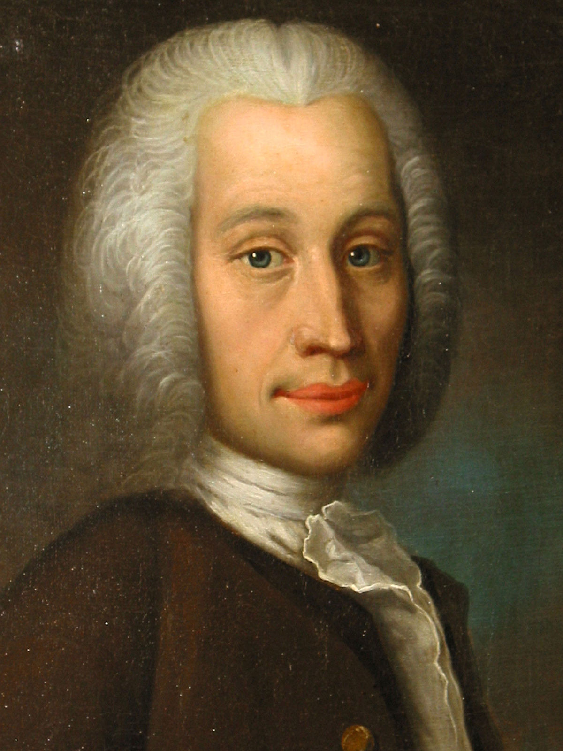
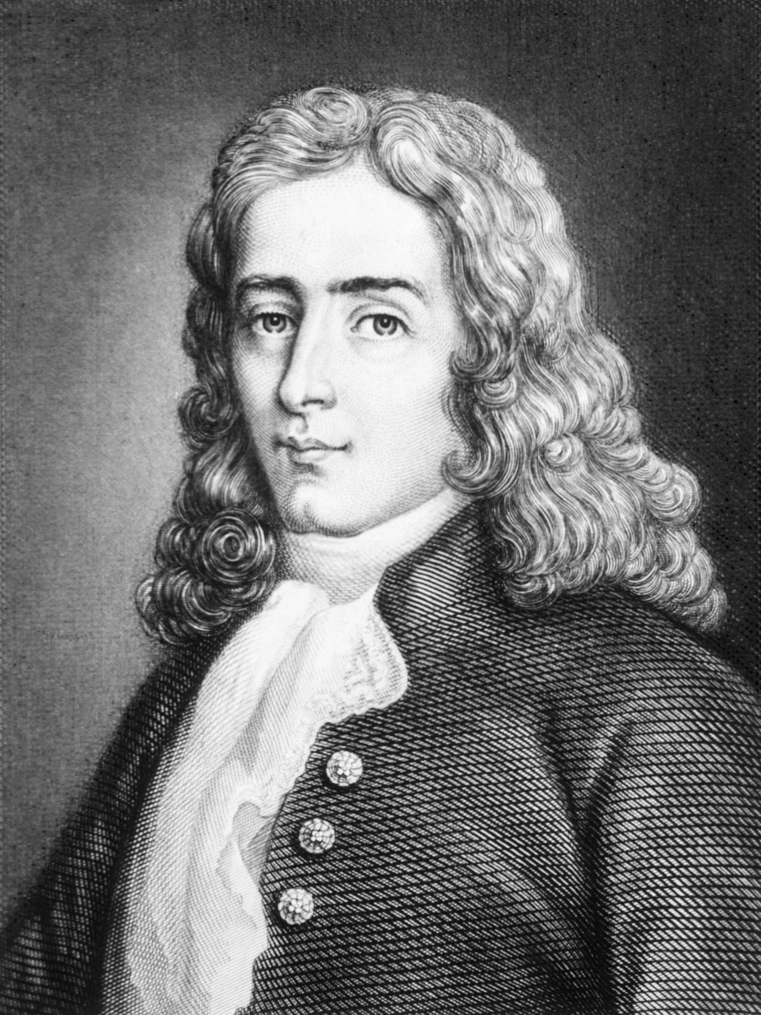
Réamur French, 1683-1757, Celsius, Swedish, 1701-1744
1
Both used freezing water, initially this was 100 on the Celsius scale
Centigrade
Réamur used only the one fixed point. He marked off thousandths of the alcohol bulb volume as it expanded. It was only later that users fixed the boiling point at 80 °R.
Octagesimal.
1742
1730

Slide 12
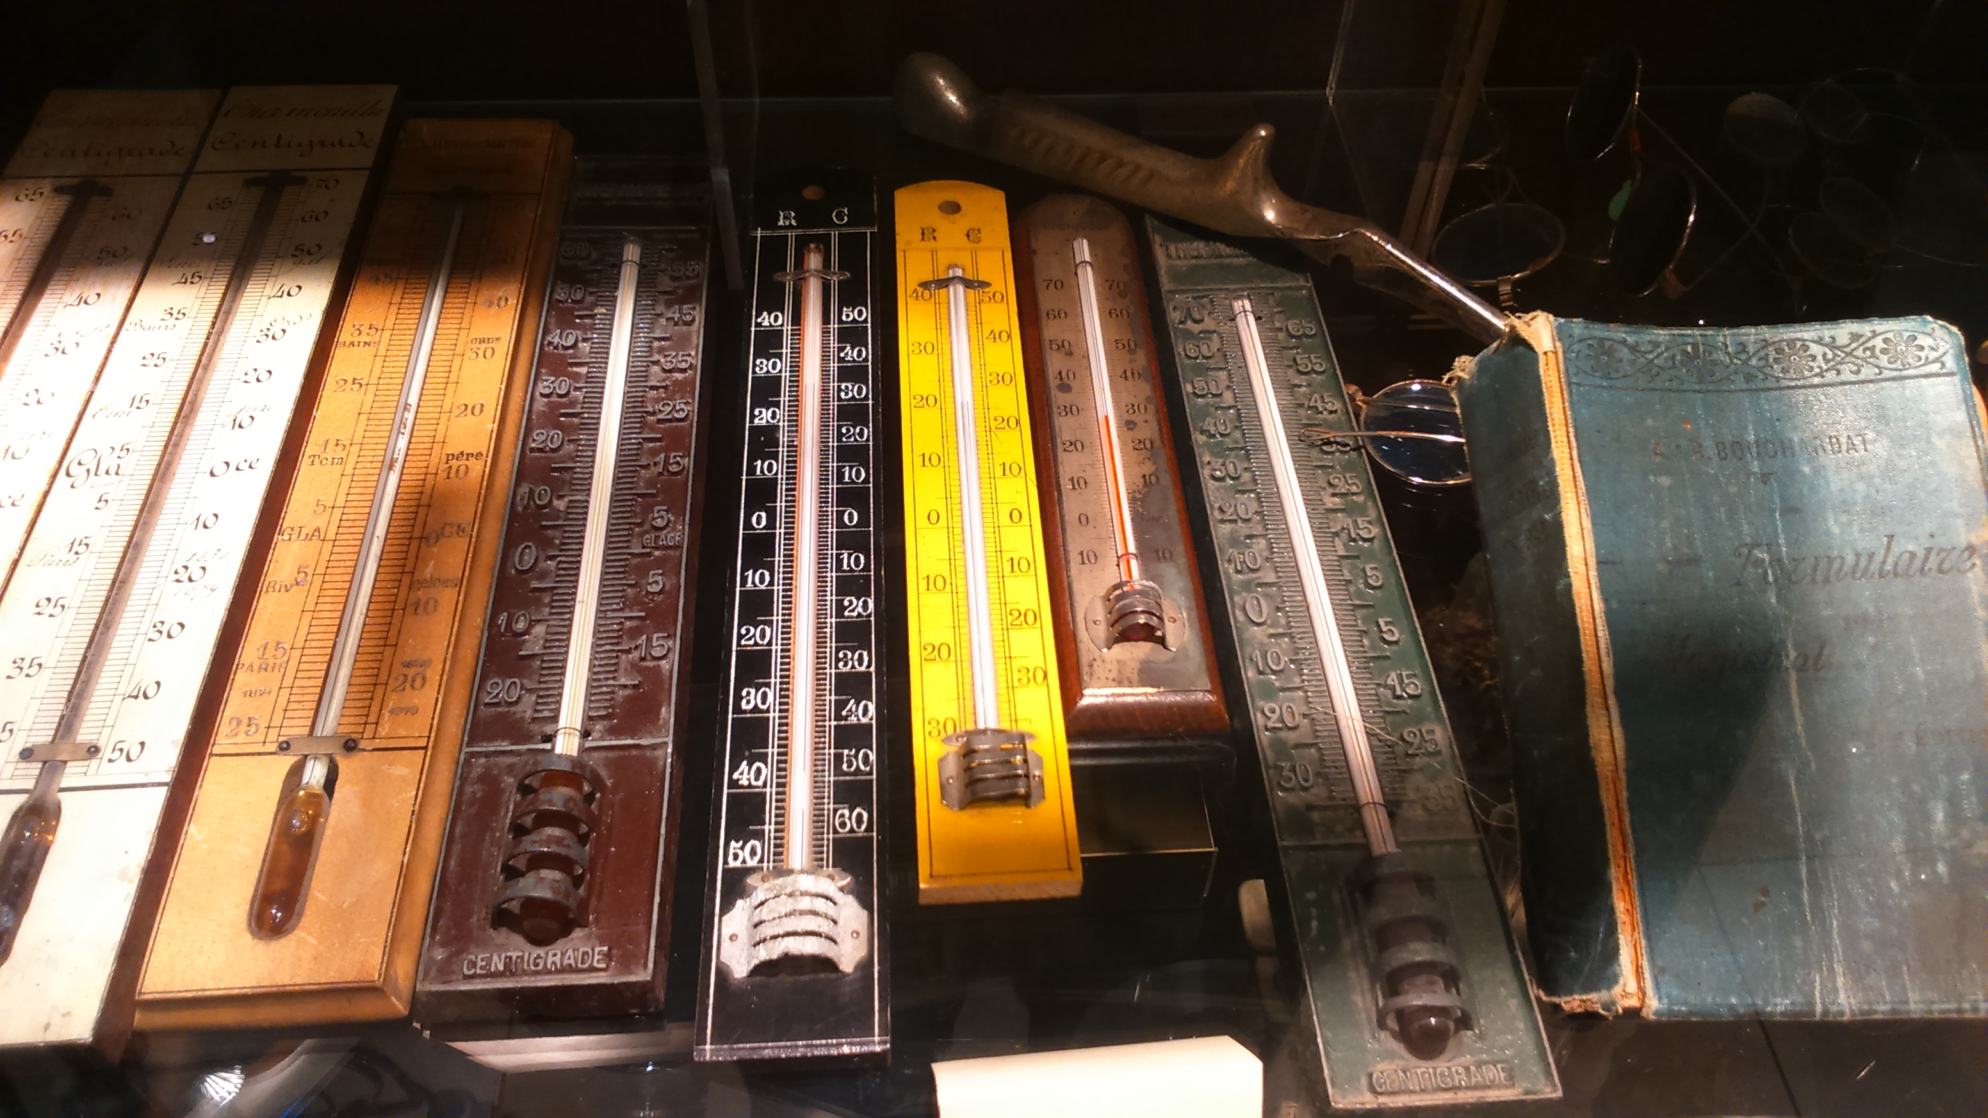
Réamur and Celsius. Medical Museum in Thessaloniki

Slide 13
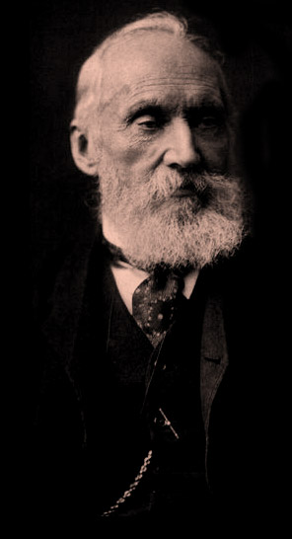
William Thomson or Lord Kelvin 1824-1907
1848, a true absolute zero with divisions to
coincide with Celsius.
1967 triple point water used, 0.01 °C, or 273.16 K
by definition.

Slide 14
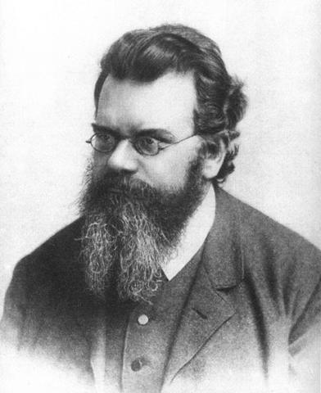
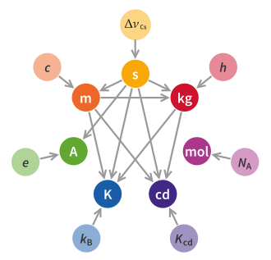
New 2019 definition of the kelvin.
k= 1.380649×10⁻²³ J⋅K⁻¹ = 1.380649×10⁻²³ kg m²s⁻² K⁻¹

Slide 15
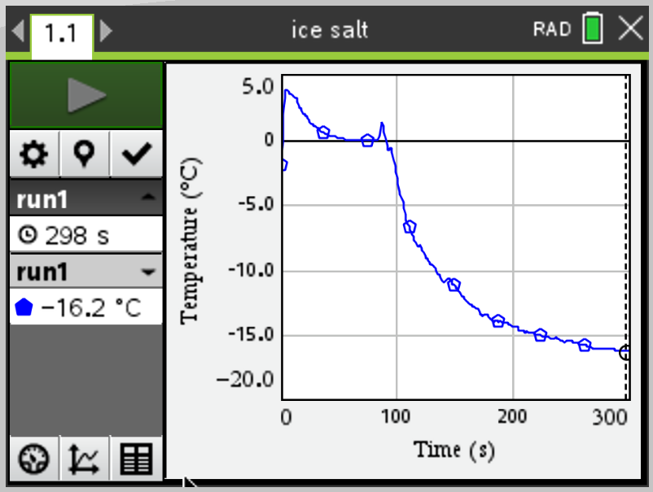
Ice and Salt
Vernier temperature probe uses NTC thermistor.
Resolution
0.17°C (–40 to 0°C)
0.03°C (0 to 40°C)
0.1°C (40 to 100°C)
0.25°C (100 to 135°C)
Accuracy
±0.2°C at 0°C,
±0.5°C at 100°C

Slide 16
Ice and Salt
At what point are Fahrenheit and Celsius the same?
What does 0 °F correspond to in Celsius?
What is the operating temperature of a freezer?

Slide 17
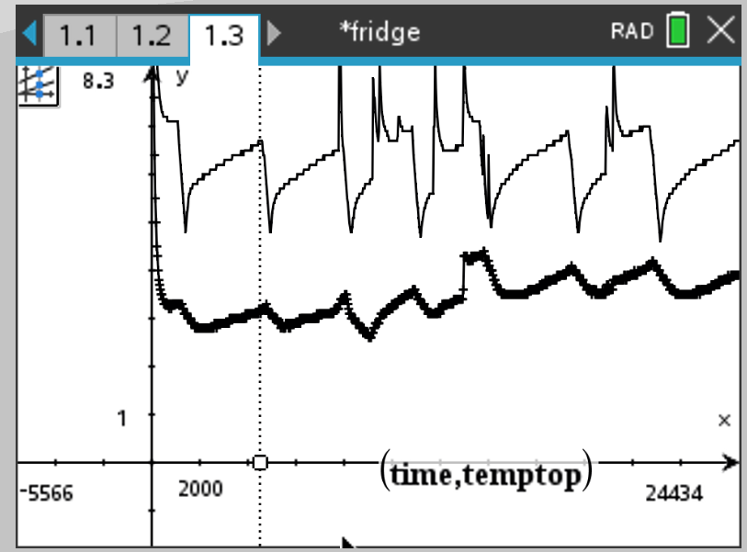
Refrigerator
Temp difference top and bottom of a refrigerator.
Thermostat operating temperatures.
Time for which refrigerator is on.
Warming starts immediately at cut off.
Lag between top and bottom.

Slide 18
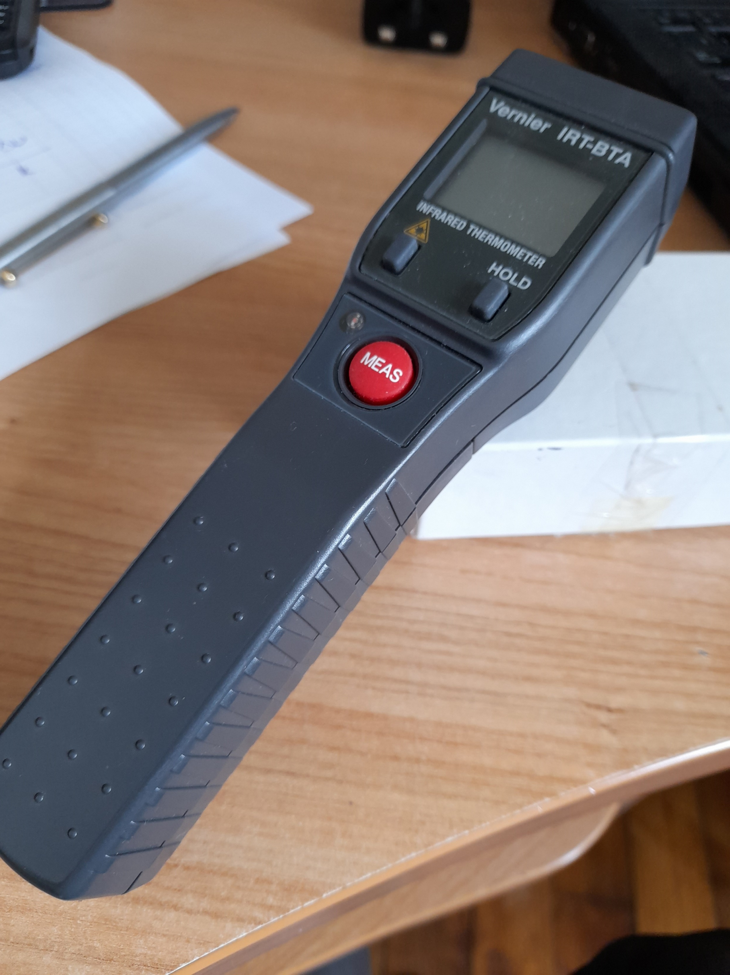
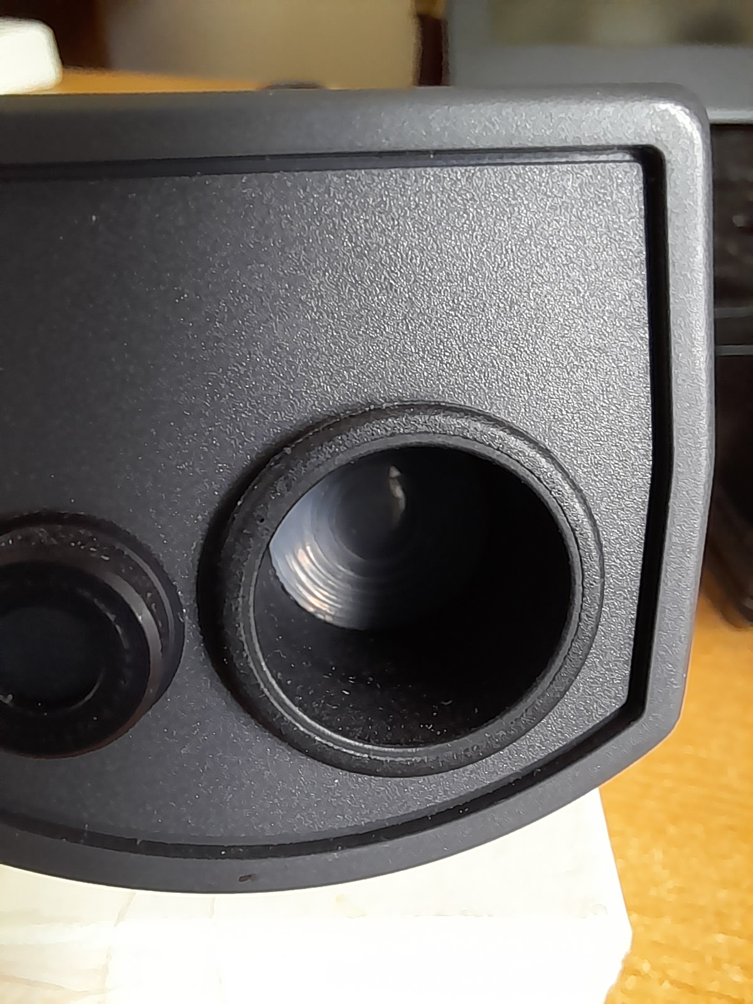
Vernier Infrared sensor
Thermopile
1 °C resolution
Sensing area just behind Fresnel screen.
Laser can be used to indicate region being sensed.

Slide 19
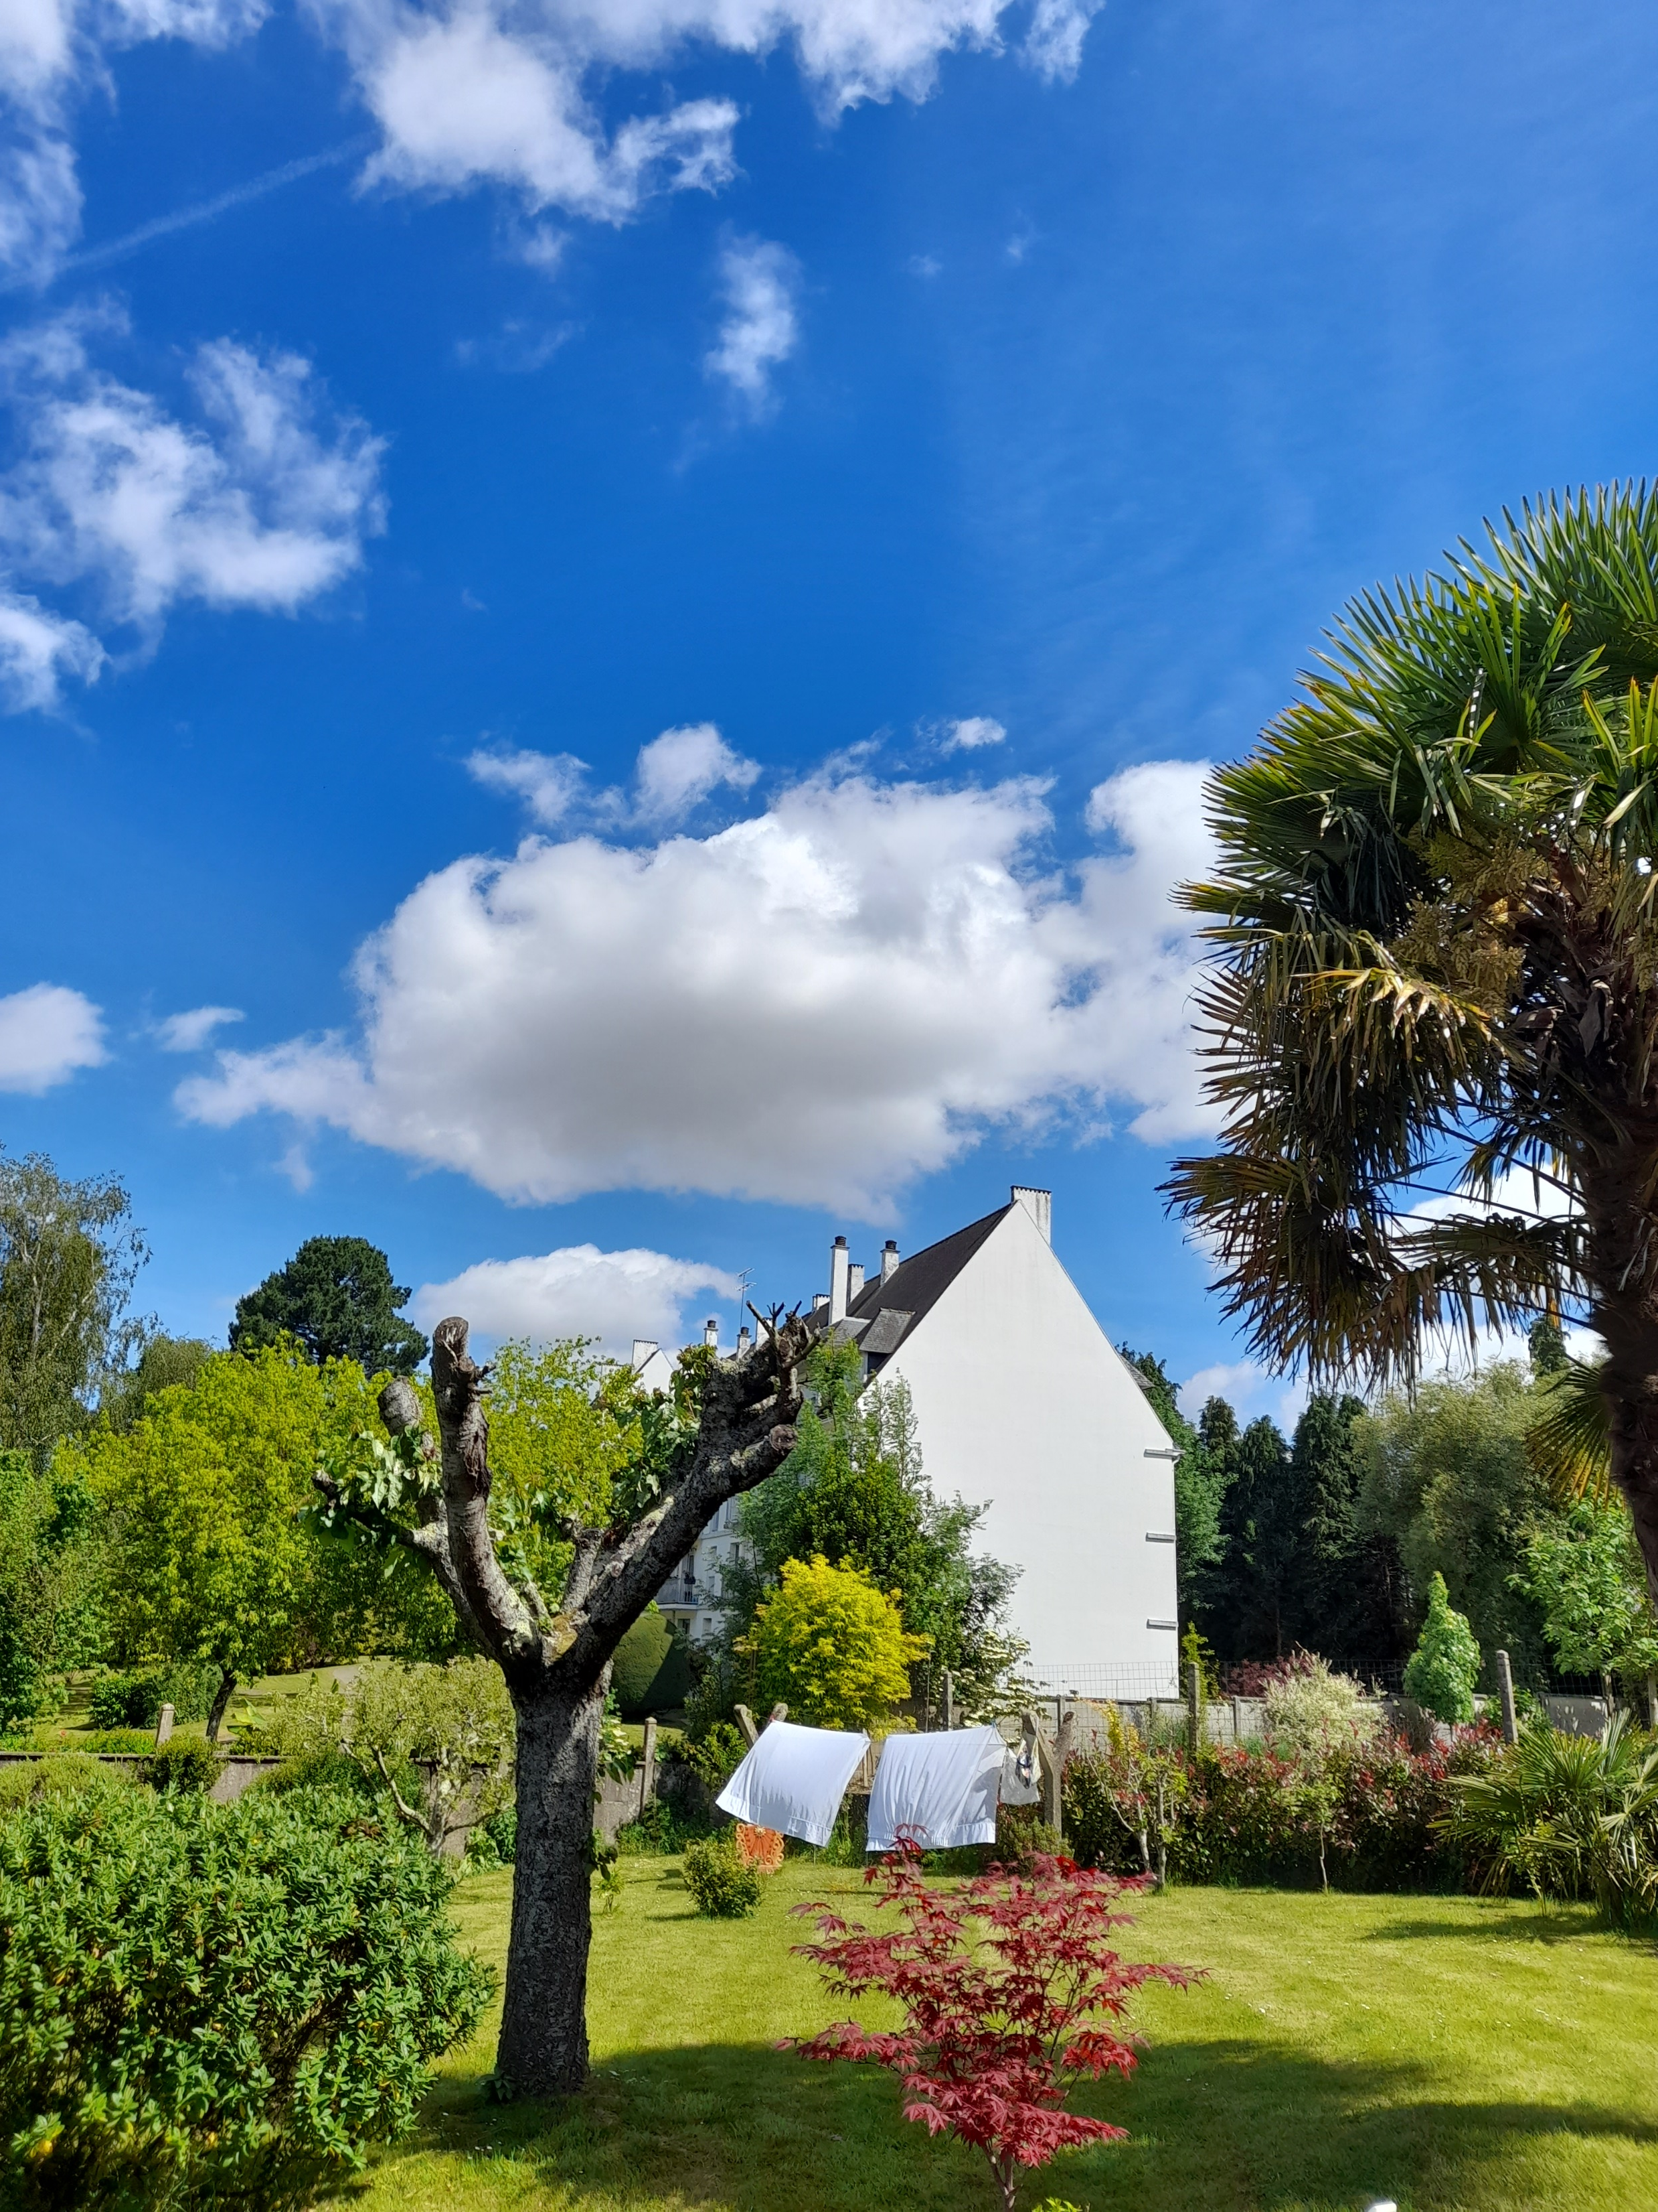
Choose a sunny day with nice well defined clouds.

Slide 20
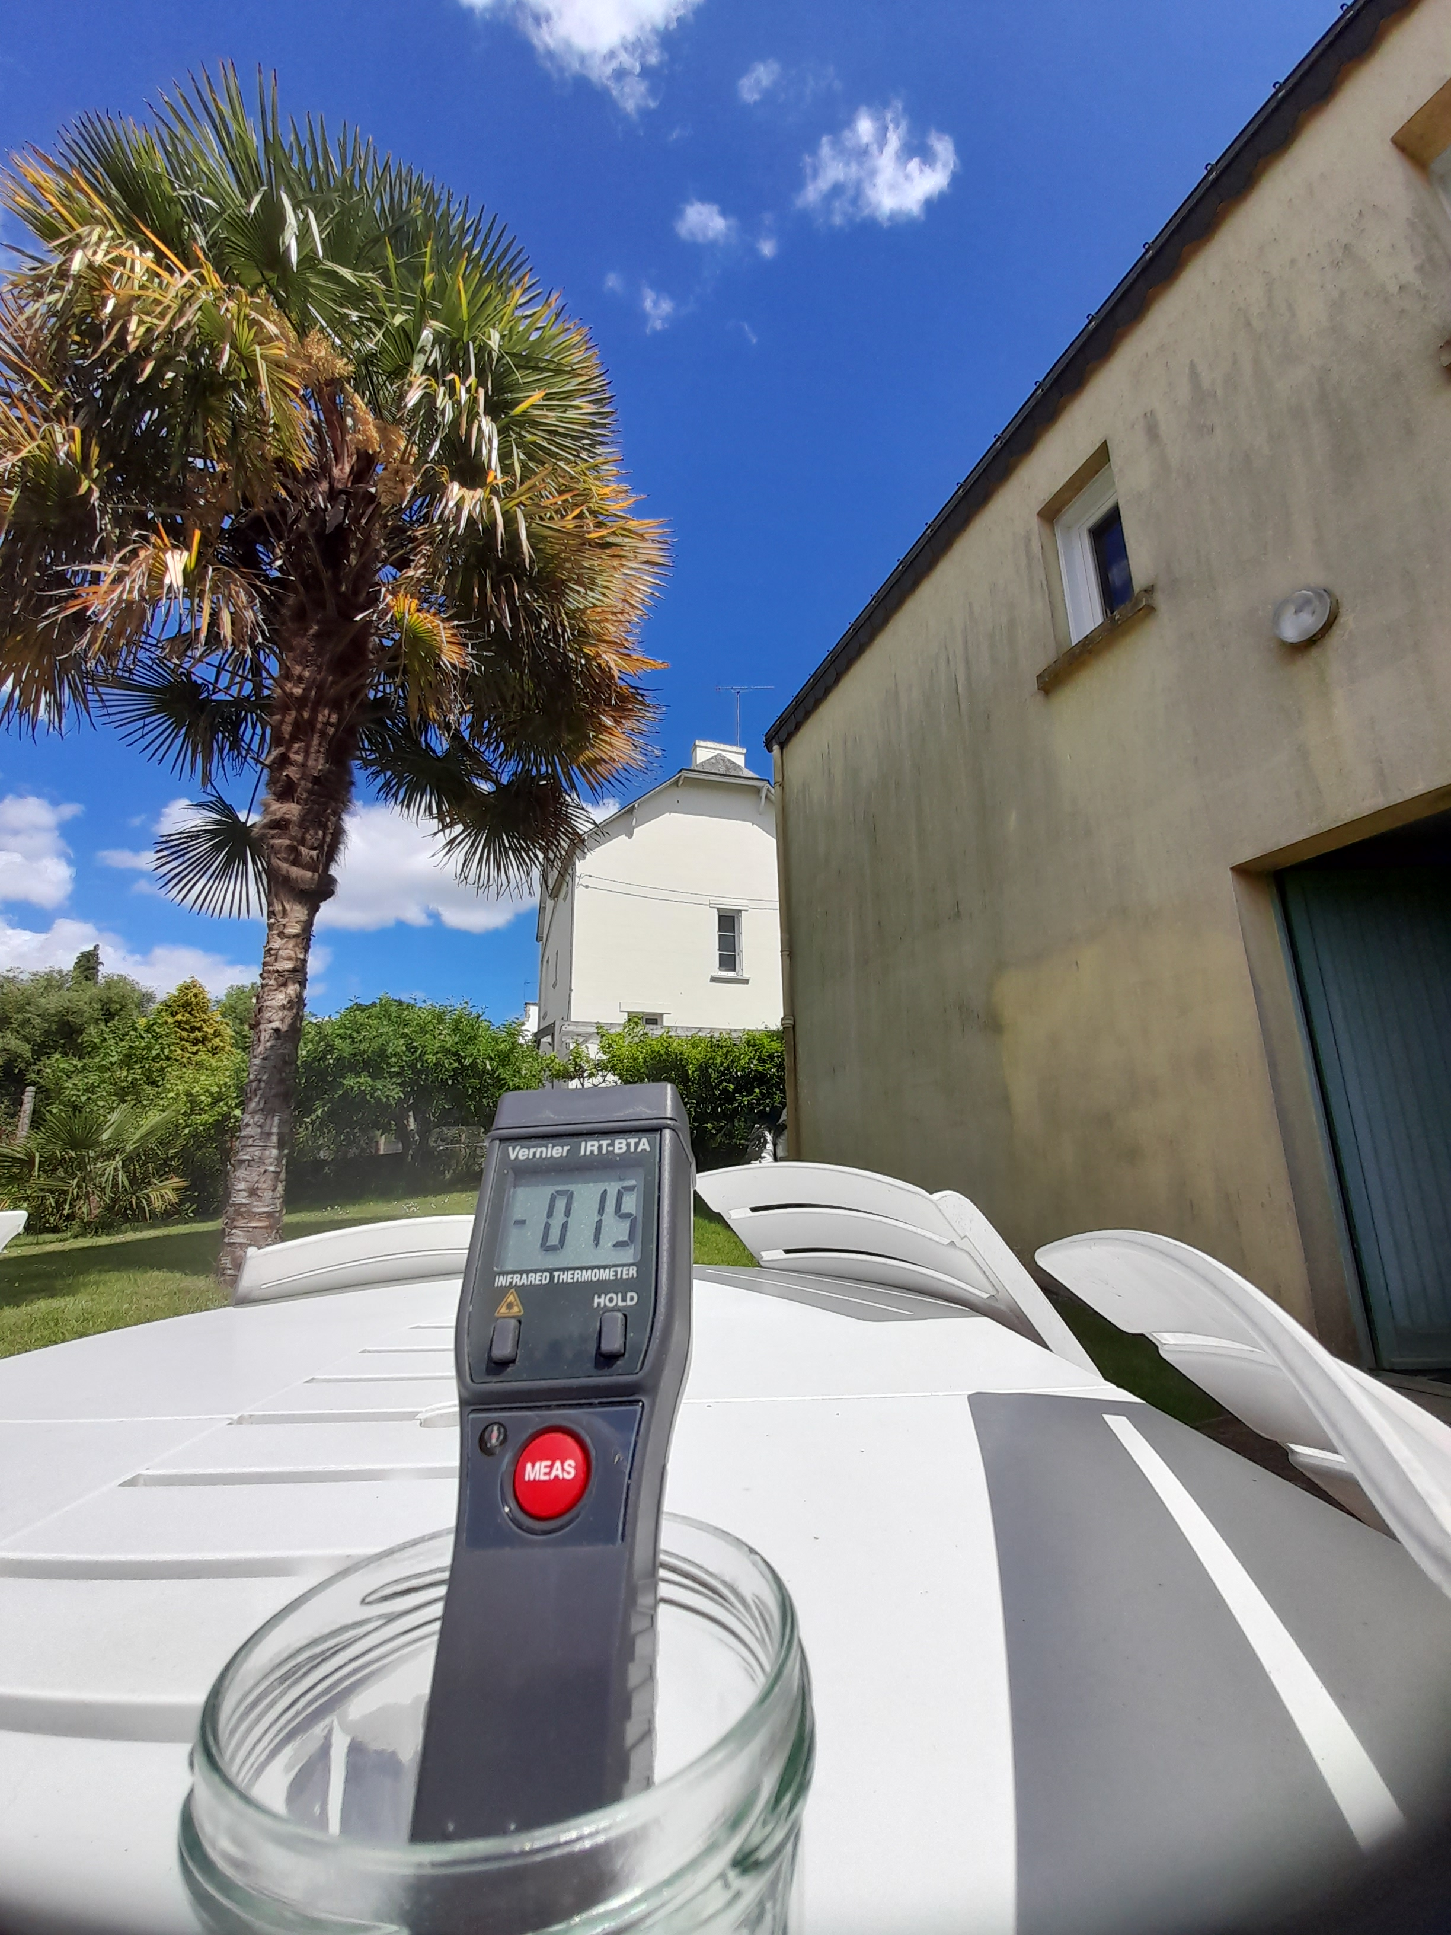
The clear blue temperature, chilly

Slide 21
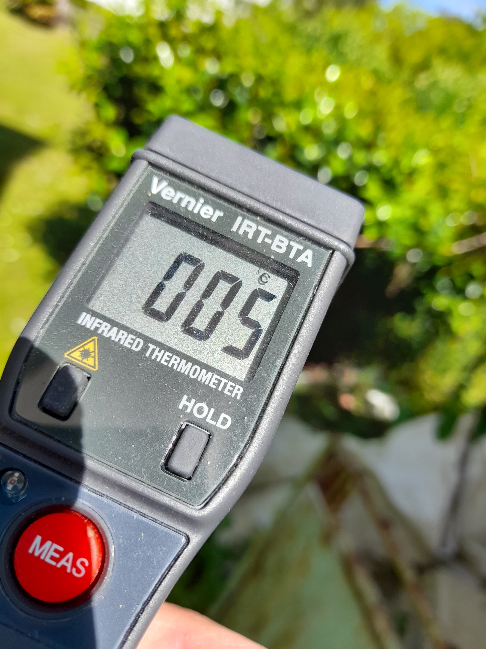
Pointing at a cloud.

Slide 22
The End (or thermodynamic equilibrium of the entire Universe, very close to 0 K)

Slide 23
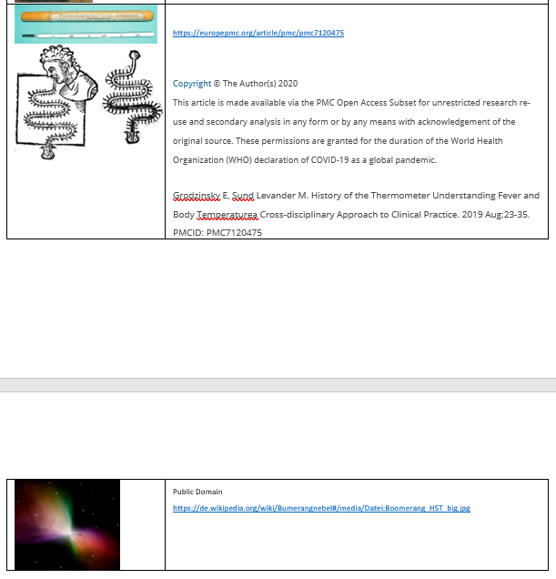
Sources and permissions

